Slide 2
Statement from the Mallee Regional Partnership Chair
The Mallee Regional Partnership has now hosted three annual assemblies and there is one issue that has been raised consistently. Each year the call for better digital connectivity has been heard loudly and clearly.
Broadband services and mobile connectivity have the potential to increase our economic performance, reduce our costs, help us learn, provide us with services and improve social connectivity.
In a region that is characterised by the large distances between settlements, digital communications has the potential to overcome the ‘tyranny of distance’.
Yet large parts of our region receive services that are inferior to more populous parts of Victoria.
As well as vast distances, the Mallee has a relatively small population. This means that it is unlikely that the Mallee will have the same standard of connectivity as is experienced in the CBD in Melbourne. However, we should expect to experience good connectivity where it is needed.
The Mallee Digital Plan provides us with a snapshot of the level of connectivity we have at present and recommends how we should improve upon the current situation.
I look forward to working with communities in the Mallee and with the Victorian and Australian Governments to realise our potential by ensuring we are better connected.
Winifred Scott
Chair
Mallee Regional Partnership

Slide 3
What is a Digital Plan?
The Digital Plan for each region is an evidence-based, place-based analysis of the supply of and demand for digital services and skills.
The Mallee Digital Plan identifies gaps in the region’s current digital infrastructure landscape and makes recommendations on how these gaps can be addressed.
This Digital Plan forms the basis of our Regional Partnerships’ advocacy to all levels of government, as well as industry and community groups. It will also be a valuable resource to other stakeholders in the region for their own advocacy and action.
Addressing the Digital Divide
Victoria’s Regional Digital Plans are the first of their kind, filling the critical information gap needed to effectively reduce the persistent country-city digital divide, defined as regional shortfalls in:
access to digital services,
the ability to effectively use these services,
and their affordability relative to their capital city counterparts.
A substantial digital gap has been found between regional Victoria and Melbourne:
2018 Rural Victoria digital inclusion score – 53
2018 Metropolitan Melbourne digital inclusion score – 64^
^ Rating from the 2018 Royal Melbourne Institute of Technology-Swinburne-Roy Morgan-Telstra Digital Inclusion Index (DII) measures the availability of digital services, the ability of residents and workers to use digital services (digital skills), and the affordability of digital services and digital expertise at a location.

Slide 4
Digital issues affecting all regions
Fixed broadband – ensuring NBN service quality is sufficient to meet resident and business needs
Mobile coverage – addressing the prevalence of blackspots
IoT (Internet of Things) – availability of networks to support the uptake of next generation technologies
Public WiFi – availability of free public WiFi for disadvantaged residents and tourists
Access to government assets to improve services locally
Digital skills – improving digital literacy, supply of IT professionals, and workforce preparedness for the future
Six technology areas have been analysed in the Digital Plans to identify supply shortages in the regions:
Mallee Priority Project and Actions
Priority Project: The Mallee Regional Partnership has identified IoT network deployment, and Public WiFi as the priority projects for the region. Building capability in utilising IoT technology is critical to underpin competitiveness and productivity in our regional industries in the years to come and Public WiFi can enhance connectivity for visitors, residents and students in key locations.
Priority Recommendations: The Mallee Digital Plan makes a series of recommendations to different stakeholder groups for their action. These recommendations include:
Local Government | Victorian Government | Commonwealth Government | NBN Co | Telco Industry
uses their local presence, insights and planning powers to identify localised fixed and mobile blackspots, influence NBN high performance technology deployment, promote early 5G rollout and facilitate digital literacy training (possibly in local digital hubs). | Revews and extends its regional telecommunications advocacy, co-investment and pilot programs to address unmet needs and capitalize on opportunities from IoT and 5G. | continues, reviews and extends its mobile blackspot co-funding program, requires NBN Co to maximise deployment of high performance technologies and systematically reduce FTTN copper loop lengths, mandates industry meets stronger NBN service connection and maintenance requirements and invests in digital skills training programs. | restructures its wholesale pricing to allow lower retail prices and encourage greater utilisation of network capacity, and quickly brings to market effective business grade services with strong service level agreements (SLAs). | actively considers opportunities to provide competing broadband services to businesses in high demand precincts, particularly if NBN Co fails to restructure its wholesale pricing or does not provide effective business grade services.

Slide 5
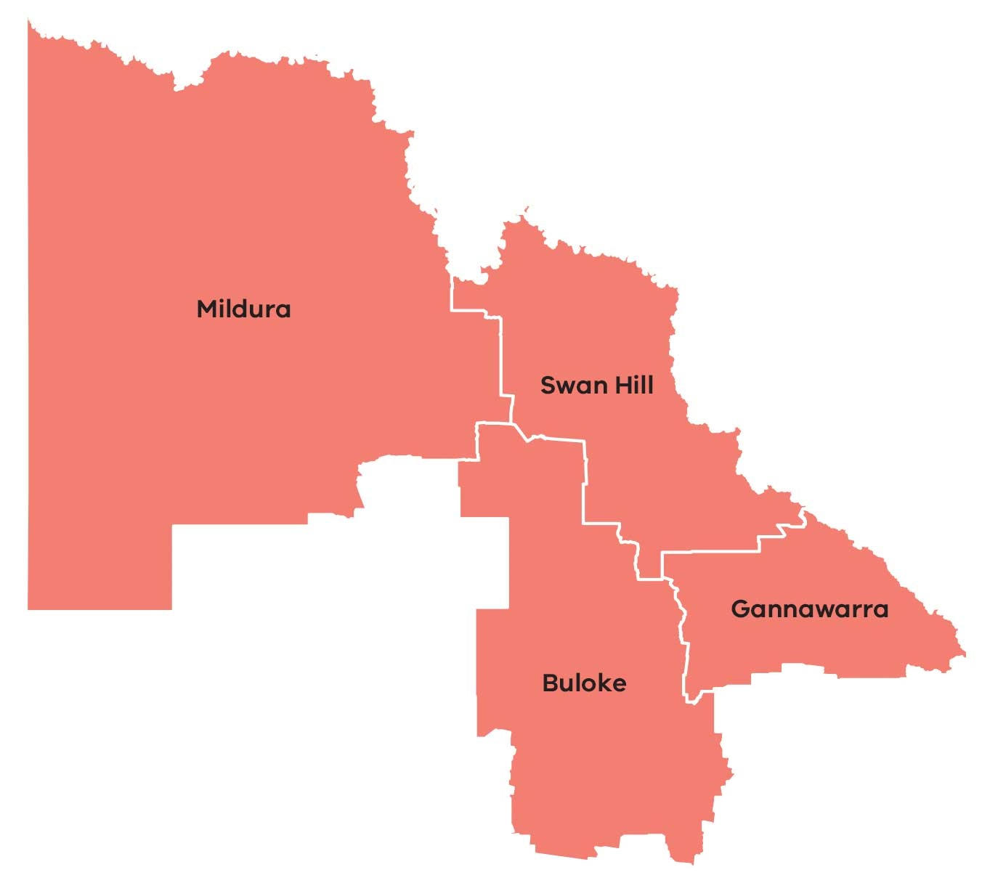
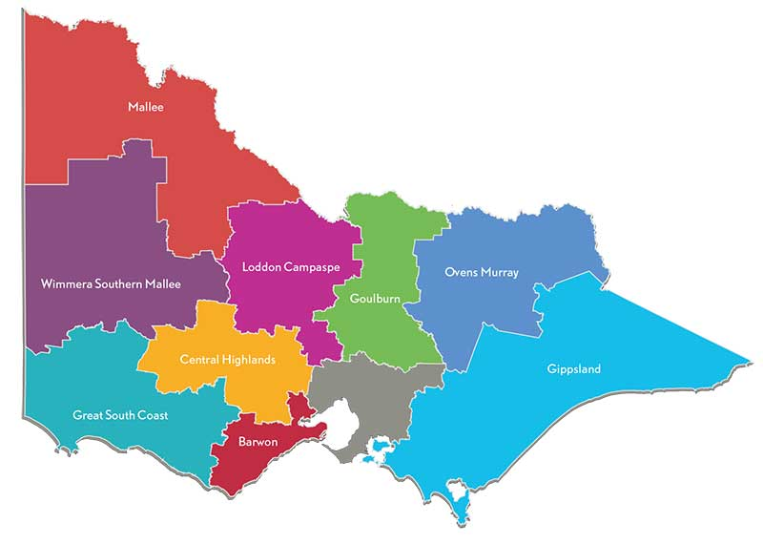
Mallee Regional Partnership – At A Glance
The Mallee Regional Partnership is one of nine Partnerships across the state, established by the Victorian Government, recognising that local communities are in the best position to understand the challenges and opportunities faced by their region.
$4.6 billion
Gross Regional Product (GRP)
92,000 residents
as of 2016
Key Industries
Agriculture, forestry, fishing (15%)
Health care & social assistance (13%)
Retail trade (11%)
Education & training (8%)
Construction (7%)
Manufacturing (6%)
Accommodation & food services (5%)
4 LGAs
Local government areas (population):
Buloke (6,000)
Gannawarra (11,000)
Mildura (55,000)
Swan Hill (20,000)
Primary Production
Fruits/nuts horticulture
Dairy grazing
Grains cropping
Approx. 40,000 km²

Slide 6
Assessment of Digital Needs
Analysis of digital supply and demand is conducted on a place- & sector- basis across the region to provide the evidence base necessary for effective digital planning. Places and sectors in the region have been analysed as follows:
→ Place/Sector Analysis
Significant Places looks at the demand and supply of digital infrastructure and services in the most populated cities, towns and localities of the region. | Primary Production looks at the most economically significant primary production industries in the region. | Tourist Locations looks at the supply of and demand for digital services in the most important tourist attractions / locations in the region. | Transport Blackspots looks at the availability of mobile services along the region’s key transport routes.
→ Digital Infrastructure Analysis
Fixed access includes National Broadband Network (NBN) fixed-line broadband services including Fibre-to-the-Premises (FttP), Fibre-to-the-Node (FttN), Fibre-to-the-Curb (FttC) and Fixed Wireless. | Mobile availability of digital mobile networks capable of supporting voice telephony and data applications such as through 3G and 4G networks.
WiFi the availability of public WiFi services such as through public libraries, cafes and fast food outlets and government initiatives. | LP-WAN IoT the availability of Low Powered Wide Area Networks (LP-WAN) that can support Internet of Things (IoT) applications like remote sensors and devices that are increasingly relevant to industry applications.

Slide 7
Mallee Regional Partnership
– Digital Vision
The Mallee Regional Partnership aims to achieve universal digital infrastructure that provides reliable, high capacity digital services that meet the needs of businesses throughout the region.
This vision will be achieved through sustained investment in digital infrastructure, connectivity and service provision that meets business and industry needs enabling local economies to diversify, be globally competitive and have access to the resources, opportunities and social outcomes afforded to all other Victorians.
Mallee Regional Partnership – Key Issues
The Mallee Regional Partnership has identified the following key issues affecting the region:
Inadequate mobile coverage
There is a persistent and significant divide in the quality of mobile services available to regional users compared to metropolitan users with important implications for public safety, economic development and general liveability. Regional users have emphasised this issue recently, registering 195 blackspots* experienced across the region as part of the Commonwealth’s black spot funding program.
The Mallee Digital Plan has necessarily relied on public mobile coverage maps provided by the carriers to undertake its analysis of mobile coverage. The analysis reveals the maps to be too high-level and low resolution to enable identification of localised areas where coverage is unreliable, weak and incapable of supporting the data services which users have come to expect to access ‘on-demand’. This means that while an area may appear well-served by these maps, the ‘lived experience’ of regional users at particular locations is often very different.
Challenges in delivering a high standard of NBN infrastructure (that is, infrastructure better than FTTN) across the Mallee region increases the importance of good mobile connectivity including both voice and data functionality. As 5G mobile networks are deployed more broadly there is also an opportunity to better meet the needs of businesses and industries with this higher capacity mobile technology.
The Mallee Regional Partnership calls for continued Commonwealth and State funding to address mobile coverage issues and better data from carriers to enable more informed funding decisions. Commonwealth funding programs that target funding based on population density and premises covered disadvantage the ability of regions like Mallee to achieve the mobile coverage needed and expected by the community and businesses.
ˇbased on the Commonwealth National Mobile Black Spot Database, last updated October 2018

Slide 8
Low adoption of Internet of Things applications
The coverage of low bandwidth Internet-of-Things (IoT) networks for agriculture, logistics, delivery of “smart city” public services and other sectors is reasonable at the moment, but availability and knowledge of IoT applications and their value-proposition is limited. It is important for regional businesses to engage with these next-generation sensor-based business practices. Early adoption across the region can underpin productivity growth and competitiveness of our industries. If the current demand trend continues we risk being left behind.
The Regional Partnership has identified IoT network deployment and agri-business IoT as a key priority project for the region.
Lack of NBN business-grade services
The availability of adequate, affordable business-grade services for regional businesses across all NBN technology types remains a concern. This is despite the introduction of NBN’s Enterprise Ethernet business service, which due to technical limitations will not be accessible to many businesses who have not received the higher capacity technologies in the rollout.
The Regional Partnership calls on the Commonwealth, NBN Co and the Victorian Government to prioritise actions that can address underserved regional business precincts with high-capacity business-grade broadband services.
Lack of WiFi networks to support residents and tourists
WiFi for residents and visitors to reliably access the internet in low income areas is lacking, with five of the places analysed identified as facing either a major or intermediate supply shortfall: Merbein, Cohuna, Donald, Charlton and Sea Lake.
High quality public WiFi networks offer a valuable alternative form of connectivity in regional and metropolitan areas alike. Visitors and tourists can utilise these networks to stay connected in areas where they may not otherwise have coverage and to find information about services and attractions, ultimately increasing their time and economic engagement with a region.
Residents in the area can use the networks either as an alternative, potentially higher quality network than what is accessible at their premises, or for residents who may not be able to afford the data allowances they use. Public WiFi also supports students and local businesses with greater data capacity and alternative connectivity options.
The Regional Partnership has also identified public WiFi as a priority project for the region.

Slide 9
Findings of the Digital Plan
→ Significant Places with a shortage of digital infrastructure
There are nine cities and towns above 1,000 people in the Mallee Regional Partnership. All of these locations have been analysed in this Digital Plan. Another five localities with less than 1,000 people were also included in the analysis to provide a broader perspective across different town sizes†.
The analysis has not looked comprehensively at smaller population centres with less than 1000 people and looks exclusively at the town centre in each location, noting that this in effect misses people living nearby in sparsely populated areas where services tend to be worse.
While our analysis of public coverage maps indicates there is generally good 4G mobile coverage within population centres, we know from regional consultations that the ‘lived experience’ for many users can be quite different. There continues to be strong regional demand for improvements in mobile services.
† based on 2016 ABS census data.
Number of places with unmet digital needs:
Of the 14 significant places analysed in the Mallee region, it was revealed that:
Fixed access broadband had an intermediate supply shortfall for nine cities/towns/localities*, with three towns, Red Cliffs, Cohuna and Donald, suffering a major supply shortfall, indicating the widespread need for business broadband needs to be further considered and addressed.
Mobile coverage was assessed as adequate within the main population centres based on multiple carriers indicating they have coverage in the area according to their coverage maps. However, there is concern whether these maps reflect the real-world experience of users. Also, what is not assessed here is how services deteriorate when moving beyond town centres. The impending rollout of 5G technology has the potential to uplift mobile services for early recipients, but smaller regional population centres not provisioned with this technology are at risk of being left further behind.
Public WiFi access was a major or intermediate supply shortfall for five places.
LP-WAN IoT was found to be reasonably good, with the exception of the town Cohuna, for the level of business, local government and household demand at present which is constrained by lack of IoT knowledge and applications across the region. Over the next 3-5 years demand is expected to grow strongly and closer attention will need to be paid to how these networks develop.
* Mildura, Swan Hill, Kerang, Robinvale, Merbein, Ouyen, Lake Boga, Leitchville.

Slide 10
→ Analysis of Primary Production in the region
The Mallee region is characterised by vast, broadly distributed areas of agriculture and broad acre cropping that deliver substantial economic value to the region in terms of both employment (15%) and contribution to Gross Regional Product (25%).
Significant aspects of Mallee primary production revolve around fruits and nuts horticulture, dairy grazing and grains cropping.
Six major primary production areas were selected for analysis in developing the Mallee Digital Plan. Importantly, these areas do not capture the full extent of the region’s primary production sector. However, they do provide indicative analysis of current digital connectivity in some of the region’s key agricultural areas, enabling general conclusions to be drawn. The adequacy of digital connectivity in other areas could be assessed in future work.
Legend
Dairy grazing
Grains cropping
Fruits/nuts horticulture
Fixed access broadband services for businesses involved in primary production needs to be addressed. In its current state, the digital infrastructure is unable to meet the region’s needs, with all locations found to have a major supply shortfall in fixed access broadband services for business users.
According to publicly available coverage maps, mobile coverage appears to be mixed – four areas revealed an intermediate supply shortfall˘ while two sites were assessed as having adequate coverage. However, stakeholder feedback consistently highlights that the ‘lived experience’ for residents and businesses is often poorer than what public coverage maps suggest, owing to the detail and resolution limitations of the maps.
Only one of the locations, Cohuna, was found to have an intermediate supply shortfall for LP-WAN IoT supported services.
Looking forward 3-5 years there is likely to be little market driven improvement in mobile coverage, and 5G technology is unlikely to replace 4G in these more remote primary production locations. Rising demand in the face of a largely static supply will mean the unmet demand situation will worsen.
Local governments and regional businesses will need to consider leveraging government assets for cost-effective bespoke solutions, and the Commonwealth and state governments should develop more flexible mobile blackspot programs tailored to the region and its needs.
Mobile coverage nearer population centres is better than services available in more remote primary production locations, however obtaining a clear picture of where specific gaps exist or where there is weak and inadequate coverage is difficult with existing public data. Better quality coverage data is becoming increasingly important to identify priority locations in need of better mobile infrastructure.
˘ Swan Hill (fruits/nuts horticulture), North of Birchip (grains cropping), West of Ouyen (grains cropping).

Slide 11
→ Analysis of Tourist Locations
The adequacy of digital infrastructure across a range of visitor locations in the Mallee region were assessed in developing the Mallee Digital Plan. These locations include year-round attractions, signature annual festivals, periodic events, and hiking trails that are frequently visited.
This representative selection of locations provides an indicative snapshot of the adequacy of digital infrastructure serving the tourism sector. Additional visitor locations and attractions could be assessed in future work.
Cullulleraine Music Festival
Hattah Kulkyne National Park
Legend
Major supply shortfall
Intermediate supply shortfall
Current supply meets or exceeds demand⁺
F M
F = Fixed access broadband
M = Mobile service coverage
F M
F M
Nyah Vinifera State Forest
Kerang Lakes
Silo Art Trail
Lake Tyrrell
Gunbower Island
Mount Wycheproof
Gateway to Gannawarra Visitor Centre
Wooroonook Lakes Campground
Big Cohuna Festival
Esoteric Festival
All locations have issues with fixed access broadband services. Most tourist spots appear to have adequate mobile coverage, but national parks and lakes are underserved. In particular, analysis revealed that Wooroonook Lakes Campground and Gunbower Island have major shortfalls in mobile coverage supply which have safety implications for visitors and tourists to these locations.
→ Analysis of Transport Corridors
Road and rail transport corridors need good mobile coverage for continuous mobile connectivity. Patchy 4G mobile coverage along key transport corridors is an impediment to the tourism and hospitality sector, impacting the ability of visitors to search for and access local information on attractions and services. Better connectivity can increase the dollar spend of visitors to the region. Ten transport corridors were analysed to provide an indicative snapshot of the digital connectivity landscape for transport.
Road Class | From | To | Mobile Coverage
A | Yamba | Mildura | 4G coverage by 2+ carriers
 | Mildura | Woosang | Continuous 4G coverage by 1 carrier only
B | Pinaroo | Tooleybuc | Limited 4G coverage
 | Ouyen | Tempy | Continuous 4G coverage by 1 carrier only
 | Woomelang | Cope Cope | 4G coverage by 2 carriers
 | Kerang | Macorna | 4G coverage by 2+ carriers
 | Robinvale | Gunbower | 4G coverage by 2+ carriers
C | 37 roads |  | Patchy/low coverage
Rail | Melbourne | Bendigo | 4G coverage by 3 carriers; good in-train reception
 | Bendigo | Swan Hill | 4G coverage by 2 carriers; uncertain in-train reception
Legend
Major supply shortfall
Intermediate supply shortfall
Current supply meets or exceeds demand⁺
⁺Note that there are reservations, based on local mobile access experience, about the good coverage indicated by public coverage maps.

Slide 12
Next Steps…
The analysis and recommendations that have come out of the Mallee Digital Plan will form the basis of our Regional Partnerships’ advocacy to the Commonwealth, Victorian and local governments, as well as industry and community groups in developing the future digital landscape of our region.
This Digital Plan highlights the region’s current gaps in digital infrastructure and where our future demands may lie, bringing to light the areas where our efforts should be focused to bridge the digital divide. By addressing these priority areas, we will ensure our local residents, businesses and community flourish as the digital age continues to advance.
The Mallee Regional Partnership would like to thank the members of Mallee Regional Digital Plan Steering Committee who gave their time, thoughts and passion towards the development of the Mallee Regional Digital Plan.
Contact Us
If you would like to discuss the Mallee Digital Plan please contact the Mallee Regional Partnership on:
Email: mallee.partnership@rdv.vic.gov.au
We look forward to hearing from you.

