Slide 1
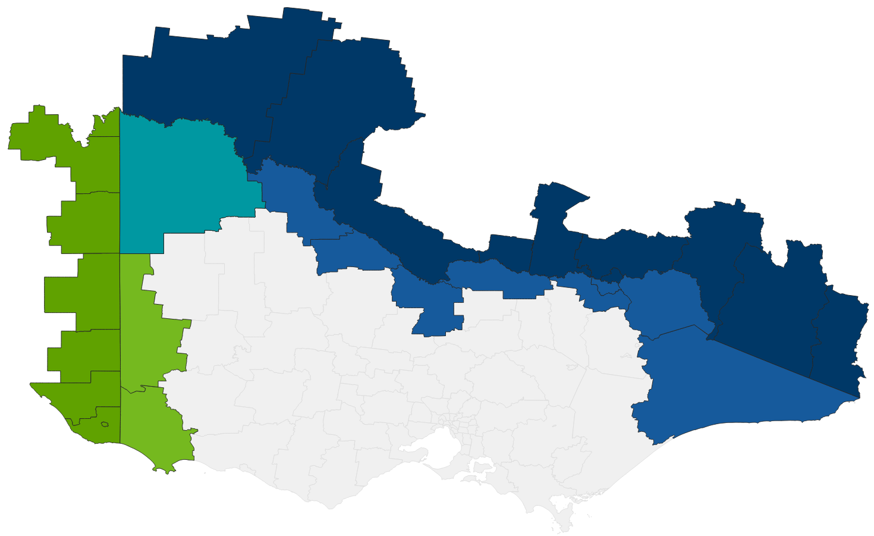
Population of Cross Border Regions
Victoria | South Australia | New South Wales | Total
299,575 | 89,157 | 187,106 | 575,838
Population along Vic SA border *MRCC included |  |  | 170,666
Population along Vic NSW border *MRCC included |  |  | 462,726
Vic population on SA border only *MRCC included |  |  | 51,305
Vic population on NSW border only *MRCC included |  |  | 275,620
*ABS Local Government Area data (2023)
Wentworth
Renmark
Paringa
Balranald
Loxton
Waikerie
Mildura
Swan Hill
Southern
Mallee
Murray River
Albury
Gannawarra
Berrigan
Federation
Greater Hume
Snowy
Valleys
Moira
Tatiara
Campaspe
Indigo
Towong
Wodonga
Snowy Monara Regional
West
Wimmera
Naracoorte
Lucindale
Bega
Valley
Wattle Range
East Gippsland
Mount
Gambier
Grant
Glenelg

