Slide 2
Statement from the
Great South Coast
Regional Partnership Chair
The Great South Coast region is a diverse area comprising our population centres of greatly varying sizes, a range of industries and primary production areas and a wealth of tourist attractions.
Whether it is a local business owner, a young student, a tourism operator, a visitor or an elderly citizen, digital connectivity is now a fundamental feature of everyone’s lives.
So ingrained are digital services in our daily lives that they are now a significant factor contributing to the liveability and growth of regional communities. No matter where we go and what we do, we must be able to connect with the people, services and information we need.
Our regional stakeholders have long suffered the challenges associated with inferior digital services, particularly those located in more remote and less densely populated areas which presents challenges for population retention and attraction.
The lack of clear evidence on where digital infrastructure gaps exist and the demand of users has been a clear barrier to improving services and better targeting investment.
In this regard, the Great South Coast Regional Partnership is pleased to present its Digital Plan.
This plan provides an initial snapshot in time of our digital infrastructure landscape and is the first ever comprehensive digital plan of its kind for our region.
The plan sets out a range of recommendations and priorities for our region which we, and we hope our many stakeholders, will pursue to address our digital divide and underpin economic development and liveability across our region.
This plan is not the final word on digital priorities. It is a starting point to guide immediate and future work and provides a useful framework to consider digital priorities and next steps for our region.
We look forward to hearing from you and continuing our local engagement to build on this important evidence base.
I would like to extend my thanks to the Great South Coast Digital Plan Steering Committee for their time and effort in developing this plan, and to the Victorian Government for their support to make this possible.
Lisa Dwyer
Chair,
Great South Coast Regional Partnership

Slide 3
What is a Digital Plan?
The Digital Plan for each region is an evidence-based, place-based analysis of the supply of and demand for digital services and skills.
The Great South Coast Digital Plan identifies gaps in the region’s current digital infrastructure landscape and makes recommendations on how these gaps can be addressed.
The Digital Plan forms the basis of our Regional Partnerships’ advocacy to all levels of government, as well as industry and community groups. It will also be a valuable resource to other stakeholders in the region for their own advocacy and action.
Addressing the Digital Divide
Victoria’s Regional Digital Plans are the first of their kind, filling the critical information gap needed to effectively reduce the persistent country-city digital divide, defined as regional shortfalls in:
access to digital services,
the ability to effectively use these services,
and their affordability relative to their capital city counterparts.
A substantial digital gap has been found between regional Victoria and Melbourne:
2019 Rural Victoria digital inclusion score – 56
2019 Metropolitan Melbourne digital inclusion score – 65^
^ Rating from the 2019 Royal Melbourne Institute of Technology-Swinburne-Roy Morgan-Telstra Digital Inclusion Index (DII)

Slide 4
Digital issues affecting all regions
Fixed broadband – ensuring NBN service quality is sufficient to meet resident and business needs
Mobile coverage – addressing the prevalence of blackspots
IoT (Internet of Things) networks – availability of low-bandwidth networks to support the uptake of next generation technologies
Public WiFi – availability of free public WiFi for disadvantaged residents and tourists
Access to government assets to improve services locally
Digital skills – improving digital literacy, supply of IT professionals, and workforce preparedness for the future
Six technology areas have been analysed in the Digital Plans to identify supply shortages in the regions:
GSC Priority Project and Actions
Priority Project: The Great South Coast Regional Partnership has identified two priority projects for the region to pursue: IoT connectivity and use and digital education initiatives. These priority areas will be critical to underpin competitiveness and productivity in our regional industries in the years to come.
Priority Actions: The Great South Coast Digital Plan makes a series of recommendations to different stakeholder groups for their action. Key recommendations are summarised below:
Local Government | Victorian Government | Commonwealth Government | NBN Co | Telco Industry
Uses their local presence, insights and planning powers to identify and confirm localised fixed and mobile blackspots, influence NBN high performance technology deployment, promote early 5G rollout and facilitate digital literacy training (including in local digital hubs). | Reviews and extends its regional telecommunications advocacy, co-investment funding and pilot programs; works with network operators to improve coverage data; addresses location-specific unmet needs from targeted highspeed broadband deployment; facilitates regional IoT and 5G developments; and expedites access for stakeholders in the region to its infrastructure visualisation tool. | Continues, reviews and extends its mobile blackspot co-funding program, requires NBN Co to maximise deployment of high performance technologies and network architecture that support business grade digital services, mandates industry meets stronger NBN service connection and maintenance requirements and invests in digital skills training programs. | Recognises the need for pricing models that encourage the adoption and realisation of latent digital opportunities in rural and regional areas.^ | Actively considers opportunities to provide competing broadband services to businesses in high demand precincts (and high speed backhaul links), particularly if NBN Co fails to restructure its wholesale pricing or does not provide effective business grade services to regional customers.
^ The Regional Partnership recognises that NBN Co is making progress on this through its Wholesale Pricing Review 2019.

Slide 5
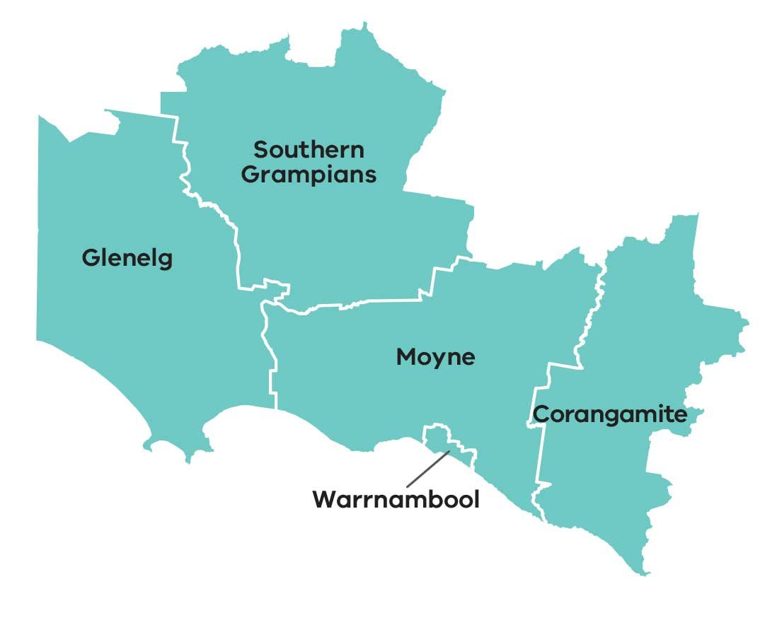
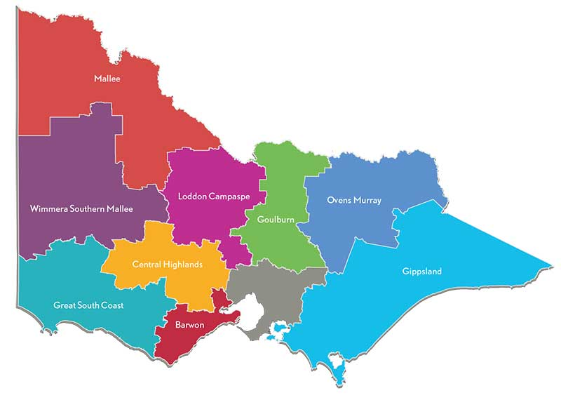
Great South Coast Regional Partnership – At A Glance
The Great South Coast Regional Partnership is one of nine Partnerships across the state, established by the Victorian Government, recognising that local communities are in the best position to understand the challenges and opportunities faced by their region.
103,000 residents
as of 2016
$5.9 billion
Gross Regional Product (GRP)
Primary Production
Sheep and beef grazing
Dairy grazing
Forestry
Horticulture
Aquaculture
5 LGAs
Local government areas (population):
Warrnambool (35,000)
Corangamite (16,000)
Glenelg (19,000)
Moyne (17,000)
South Grampians (16,000)
Key Industries
Agriculture/forestry/fishing (16%)
Health care/social assistance (14%)
Retail trade (10%)
Education/training (8%)
Manufacturing (8%)
Tourism (8%)
Construction (7%)
3,761 jobs
form part of the Tourism, Events and Visitor Economy in the region
Approx. 23,000 km²

Slide 6
Assessment of Digital Needs
Analysis of digital supply and demand is conducted on a place & sector basis across the region to provide the evidence base necessary for effective digital planning. Places and sectors in the region have been analysed as follows:
→ Place/Sector Analysis
Significant Places looks at the demand and supply of digital infrastructure and services in the most populated cities, towns and localities of the region. | Primary Production looks at the most economically significant primary production industries in the region. | Tourist Locations looks at the supply of and demand for digital services in the most important tourist attractions / locations in the region. | Transport Blackspots looks at the availability of mobile services along the region’s key transport routes.
→ Digital Infrastructure Analysis
Fixed access includes National Broadband Network (NBN) fixed-line broadband services including Fibre-to-the-Premises (FttP), Fibre-to-the-Node (FttN), Fibre-to-the-Curb (FttC), Fixed Wireless and Satellite. | Mobile availability of digital mobile networks capable of supporting voice telephony and data applications such as through 3G and 4G networks.
WiFi the availability of public WiFi services such as through public libraries and buildings, information centres and other local government initiatives. | LP-WAN IoT the availability of Low Powered Wide Area Networks (LP-WAN) that can support Internet of Things (IoT) applications like remote sensors and devices that are increasingly relevant to industry applications.

Slide 7
Great South Coast Regional Partnership – Key Issues
The Great South Coast Digital Plan identifies a number of digital connectivity issues across our region which adversely impact our economic and social development and general liveability, with important implications for population attraction and retention across our regional cities and towns. Of particular importance are the following issues:
Inadequate mobile coverage
There is a persistent and significant divide in the quality of mobile services available to regional users compared to metropolitan users with important implications for public safety, economic development and general liveability. Regional users have emphasised this issue recently, registering 262 blackspotsˇ experienced across the Great South Coast region as part of the Commonwealth’s black spot funding program.
The Digital Plan has necessarily relied on public mobile coverage maps provided by the carriers. The analysis reveals the maps to be too high-level and low resolution to enable detailed identification of areas where coverage is unreliable, weak and/or incapable of supporting the data services which users have come to expect to access ‘on-demand’. This means that while an area may appear well-served by these maps, the ‘lived experience’ of regional users is often very different. The analysis summarised on the following pages should be read with this in mind. Better data in the future can provide a more complete picture about mobile coverage issues within towns and in areas not yet analysed by the Digital Plans.
The Regional Partnership calls for continued Commonwealth and State funding to address mobile coverage issues and better data from carriers to enable more informed funding decisions.
Low up-take of Internet of Things applications
The coverage of low bandwidth Internet-of-Things (IoT) networks for agriculture, logistics, delivery of “smart city” public services and other sectors is reasonable at the moment, but availability and knowledge of IoT applications and their value-proposition is limited. It is important for regional businesses to engage with these next-generation sensor-based business practices. Early adoption across the region can underpin productivity growth and competitiveness of our industries. If the current demand trend continues we risk being left behind.
The Regional Partnership has identified IoT connectivity and use as a priority project for the region.
Lack of NBN business-grade services
The availability of adequate, affordable business-grade services for regional businesses across all NBN technology types remains a concern. This is despite the introduction of NBN’s Enterprise Ethernet business service, which due to technical limitations will not be accessible to many businesses who have not received the higher capacity technologies in the rollout.
The Regional Partnership calls on the Commonwealth, NBN Co and the Victorian Government to prioritise actions that can address underserved regional business precincts with high-capacity business-grade broadband services.
ˇbased on the Commonwealth National Mobile Black Spot Database, last updated October 2018

Slide 8
Findings of the Digital Plan
→ Significant Places with a shortage of digital infrastructure
There are 11 cities and towns above 1,000 people in the Great South Coast Regional Partnership. All of these locations have been analysed in this Digital Plan. Another four localities with less than 1,000 people were also included in the analysis to provide a broader perspective of different town sizes†.
The analysis has not looked comprehensively at smaller population centres with less than 300 people and looks exclusively at the town centre in each location, noting that this in effect misses people living nearby in sparsely populated areas where services tend to be worse.
While our analysis of public coverage maps indicates there is generally good 4G mobile coverage within population centres, we know from regional consultations that the ‘lived experience’ for many users can be quite different with continuing demand for better mobile infrastructure.
† based on 2016 ABS census data.
Number of places with unmet digital needs:
Of the 15 significant places analysed in the Great South Coast region, it was revealed that:
Fixed access broadband had an intermediate supply shortfall for 10 cities/towns/localities*, with three towns, Casterton, Heywood and Mortlake, suffering a major supply shortfall, indicating the widespread need for business broadband needs to be further considered and addressed.
Mobile coverage was assessed as adequate within the main population centres based on multiple carriers indicating they have coverage in the area according to their coverage maps. However, there is concern whether these maps reflect the real-world experience of users, and what is not assessed here is how services deteriorate when moving beyond town centres. Only one locality, Cape Bridgewater, was found to have an intermediate supply shortfall. The impending rollout of 5G technology has the potential to uplift mobile services for early recipients, but smaller regional population centres are at risk of being left further behind.
Public WiFi access was a major supply shortfall for seven places.
LP-WAN IoT was found to be reasonably good for the level of business, local government and household demand at present which is constrained by lack of IoT knowledge and applications across the region. Over the next 3-5 years demand is expected to grow strongly and closer attention will need to be paid to how these networks develop.
* Warrnambool, Portland, Hamilton, Port Fairy, Camperdown, Terang, Koroit, Cobden, Timboon, Cape Bridgewater.

Slide 9
→ Analysis of Primary Production in the region
Primary production in the region revolves around sheep and beef grazing, dairy grazing, horticulture, forestry and aquaculture.
The ten locations analysed cover all the major types of primary production seen throughout the Great South Coast region.
Legend
Sheep and beef grazing
Dairy grazing
Forestry
Horticulture
Aquaculture
South of Balmoral
East of Hamilton
Between Macarthur and Mortlake
West of Dartmoor
East of Nelson
Around Heywood
Between Camperdown and Warrnambool
North-East Portland
2891 Princes Highway Port Fairy
Snapper Point Road Narrawong
Fixed access broadband services for businesses involved in primary production needs to be addressed. In its current state, the digital infrastructure is unable to meet the region’s needs, with all locations found to have a major supply shortfall in fixed access broadband satellite services for business users.
According to publicly available coverage maps, mobile coverage appears to be mixed – three revealed a major shortfall and one had an intermediate shortfall˘. Despite six sites reporting adequate coverage, it has been highlighted through consultation that the ‘lived experience’ for residents and businesses is often poorer than what coverage maps suggest, owing to the detail and resolution limitations of the maps.
Three of the locations, Between Macarthur and Mortlake, West of Dartmoor and East of Nelson, were found to have an intermediate supply shortfall for LP-WAN IoT supported services.
Mobile coverage nearer population centres is better than services available in more remote primary production locations, however obtaining a clear picture of where specific gaps exist or where there is weak and inadequate coverage is difficult with existing public data. Better quality coverage data is becoming increasingly important to identify priority locations in need of better mobile infrastructure.
Looking forward 3-5 years there is likely to be little market driven improvement in mobile coverage, and 5G technology is unlikely to replace 4G in these locations. Rising demand in the face of a largely static supply will mean the unmet demand situation will worsen.
Local governments and regional businesses will need to consider leveraging government assets for cost-effective bespoke solutions, and the Commonwealth and state governments should develop more flexible mobile blackspot programs tailored to the region and its needs.
˘ Major: South of Balmoral (sheep & beef grazing), between Macarthur and Mortlake (sheep & beef grazing), East of Nelson (forestry). Intermediate: west of Dartmoor (sheep & beef grazing).

Slide 10
→ Analysis of Tourist Locations
Tourist sites include year-round attractions, signature annual festivals, periodic events, and hiking trails that are frequently visited.
Tourist locations, including 11 permanent spots, three events and four trails were assessed on the adequacy of digital infrastructure‡:
Wannon and Nigretta Falls
Grampians Peaks Trail
Budj Bim National Heritage Landscape
SheepVention
May Race Carnival Warrnambool
Great South West Walk
Noorat, Glenormiston and Terang
Cape Bridgewater Whale Watching and Seal Tour
Twelve Apostles Gourmet Trail
Portland Whale Watching Platform
Kennedy’s Creek Music Festival
Port Fairy Township
Great Ocean Walk
Port Fairy Folk Festival
Port Campbell Township
Twelve Apostles
Tower Hill Wildlife Reserve
Logans Beach Whale Viewing Platform, Warrnambool
Legend
Major supply shortfall
Intermediate supply shortfall
Current supply meets or exceeds demand⁺
F = Fixed access broadband
M = Mobile service coverage
All locations have issues with fixed access broadband services. Most tourist spots appear to have adequate mobile coverage, but national parks and trails are underserved.
F M
F M
F M
‡ Analysis combines operator and visitor user types.
→ Analysis of Transport Blackspots
Road and rail transport corridors need good mobile coverage for continuous mobile connectivity. Sixteen transport corridors were analysed below:
Road Class | From | To | Mobile coverage
A | Colac | Mt Gambier | Coverage by all 3 carriers
 | Horsham | Heywood | Coverage by at least 2 carriers
B | Wattle Hill | Allansford | Coverage by all 3 carriers
 | Warrnambool | Mortlake | Coverage by all 3 carriers
 | Cressy | Hamilton | Coverage by at least 2 carriers
 | Hamilton | Glenthompson | Coverage by at least 2 carriers
C | Portland | Nelson | Partial coverage by all carriers only
 | Portland | Casterton | Coverage by all 3 carriers
 | Woolsthorpe | Heywood | Coverage by all 3 carriers
Rail (passenger) | Geelong | Melbourne | Coverage by 3 carriers
 | Warrnambool | Geelong | Coverage by 3 carriers, in-carriage coverage needs to be verified
Rail (freight) | Maroona (Ararat) | Hamilton | Not relevant for passenger use
 | Hamilton | Portland | Not relevant for passenger use
Airports | Portland |  | Coverage by 3 carriers
 | Warrnambool |  | Coverage by 3 carriers
 | Hamilton |  | Coverage by 1 carrier
Legend
Major supply shortfall
Intermediate supply shortfall
Current supply meets or exceeds demand⁺
⁺Note that there are reservations, based on local mobile access experience, about the good coverage indicated by public coverage maps.

Slide 11
Next Steps…
The analysis and recommendations that have come out of the Great South Coast Digital Plan will form the basis of our Regional Partnerships’ advocacy to the Commonwealth, Victorian and local governments, as well as industry and community groups in developing the future digital landscape of our region.
This Digital Plan highlights the region’s current gaps in digital infrastructure and where our future demands may lie, bringing to light the areas where our efforts should be focused to bridge the digital divide. By addressing these priority areas, we will ensure our local residents, businesses and community flourish as the digital age continues to advance.
The Great South Coast Regional Partnership would like to thank the members of Great South Coast Regional Digital Plan Steering Committee who gave their time, thoughts and passion towards the development of the Great South Coast Regional Digital Plan.
Contact Us
If you would like to discuss the Great South Coast Regional Digital Plan please contact the Great South Coast Regional Partnership on:
Email: greatsouthcoast.partnership@rdv.vic.gov.au
Phone: (03) 5561 9965
We look forward to hearing from you.

