Slide 2
Regional Partnership Foreword
It is with great pleasure that we provide our Central Highlands Digital Plan, which has been endorsed and adopted by the Central Highlands Regional Partnership committee.
Through the funding and support of the Connecting Regional Communities Program, a diverse array of expertise and knowledge was brought together to develop the State Level Information management Database (SLIM) to examine place-based digital infrastructure supply and demand, to explore common digital issues affecting regional communities and to develop and implement digital plans for each of the nine Regional Partnerships.
These resources will empower us both collectively and in our individual Partnership regions, to provide evidence-based proof of where the Digital Divide lies in our regions and map the impacts and effects, both in its existence and progressively and increasingly, in its closure. Once this is done, there will be a continuous process of updating the Digital Plans and proactively pursuing actions and initiatives with the aim of seeking parity and equity in terms of Digital Connectivity and services.
There has never been such a consistent, coordinated and focused initiative by any Government in Australia; one that draws together a uniform approach across the State but also recognises specific and parochial challenges with which each Regional Partnership is faced. Its value and utility is set only to grow as the SLIM database gets bigger, the Digital Plans are refined, matured and evolved and the communities and businesses of Regional Victoria take full advantage of the unquestionable and transformational benefits of digital connectivity and the digital economy.
The Central Highlands Digital Plan is the first of the nine to be developed for each of the Partnerships, and it has been our privilege to be involved with the teams from Regional Development Victoria, from the Department of Jobs, Precincts and Regions and consultants, in working through the initial design and architecture of the SLIM database and Digital Plans through to their completion.
On behalf of all regional Victorians, and especially those in the Central Highlands, I am grateful to the State Government and especially Ministers Martin Pakula and Jaclyn Symes and their teams, for listening to what we had to say and underwriting this massive and ground-breaking initiative.
George Fong
Chair, Central Highlands Regional Partnership

Slide 3
What is a Digital Plan?
The Digital Plan for each region is an evidence-based, place-based analysis of the supply of and demand for digital services and skills.
The Central Highlands Digital Plan identifies gaps in the region’s current digital infrastructure landscape and makes recommendations on how these gaps can be addressed.
The Digital Plan forms the basis of our Regional Partnerships’ advocacy to all levels of government, as well as industry and community groups. It will also be a valuable resource to other stakeholders in the region for their own advocacy and action.
Addressing the Digital Divide
Victoria’s Regional Digital Plans are the first of their kind, filling the critical information gap needed to effectively reduce the persistent country-city digital divide, defined as regional shortfalls in:
access to digital services,
the ability to effectively use these services,
and their affordability relative to their capital city counterparts.
A substantial digital gap has been found between regional Victoria and Melbourne:
2018 Rural Victoria digital inclusion score – 53
2018 Metropolitan Melbourne digital inclusion score – 64^
^ Rating from the 2018 Royal Melbourne Institute of Technology-Swinburne-Roy Morgan-Telstra Digital Inclusion Index (DII)

Slide 4
Digital issues affecting all regions
Fixed broadband – ensuring NBN service quality is sufficient to meet resident and business needs
Mobile coverage – addressing the prevalence of blackspots
IoT (Internet of Things) networks – availability of low-bandwidth networks to support the uptake of next generation technologies
Public WiFi – availability of free public WiFi for disadvantaged residents and tourists
Access to government assets to improve services locally
Digital skills – improving digital literacy, supply of IT professionals, and workforce preparedness for the future
Six technology areas have been analysed in the Digital Plans to identify supply shortages in the regions:
Central Highlands Priority Project and Actions
Priority Project: The Central Highlands Regional Partnership has identified Digital Hubs as a priority project for the region.
Priority Actions: The Central Highlands Digital Plan makes a series of recommendations to different stakeholder groups for their action. Key recommendations are summarised below:
Local Governments | Victorian Government | Commonwealth Government | NBN Co | Telco Industry
use their local presence, insights and planning powers to identify localised fixed and mobile blackspots, influence NBN high performance technology deployment and early business grade service deployment, promote early 5G rollout and facilitate digital literacy training in local digital hubs (Local Community Connectivity Centres). | continues, reviews and extends its regional telecommunications advocacy, co-investment and pilot programs to address unmet broadband and mobile needs and capitalise on opportunities from IoT and 5G. | continues, reviews and extends its mobile blackspot co-funding program, requires NBN Co to maximise deployment of high performance technologies, mandates industry meets stronger NBN service connection and maintenance requirements and invests in digital skills training programs. | restructures its wholesale pricing to allow lower retail prices and encourage greater utilisation of network capacity, and quickly brings to market effective business grade services with strong service level agreements (SLAs). | actively considers opportunities to provide competing broadband services to businesses in high demand precincts, particularly if NBN Co fails to restructure its wholesale pricing or does not provide effective business grade services.

Slide 5
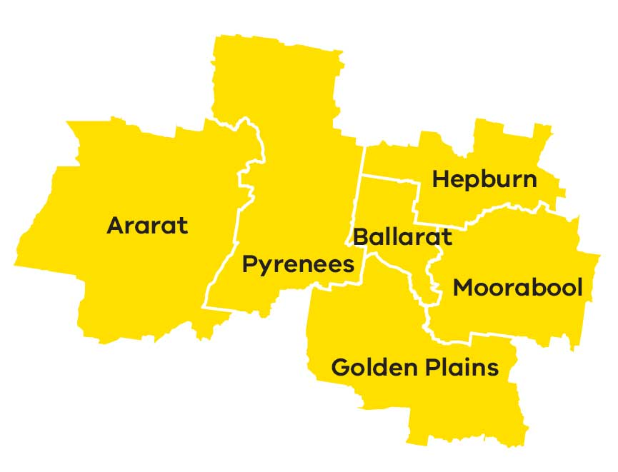
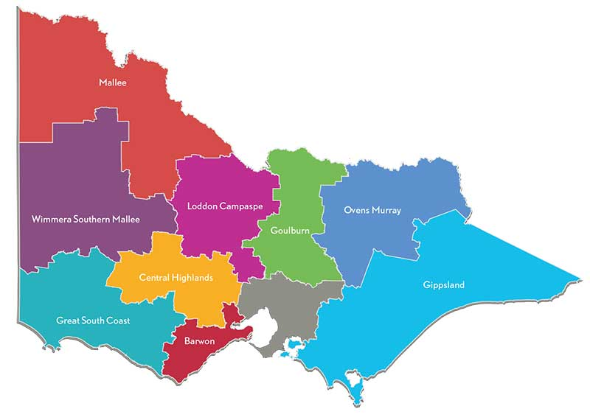
Central Highlands Regional Partnership – At A Glance
The Central Highlands Regional Partnership is one of nine Partnerships across the state, established by the Victorian Government, recognising that local communities are in the best position to understand the challenges and opportunities faced by their region.
195,000 residents
as of 2017
Primary Production
Sheep and beef grazing
Cropping/mixed farming
Potatoes
Intensive livestock
Intensive horticulture
Forestry
$8 billion
Gross Regional Product (GRP)
6 LGAs
Local government areas (population):
Ballarat (106,000)
Moorabool (33,000)
Golden Plains (22,000)
Hepburn (16,000)
Ararat (12,000)
Pyrenees (7,000)
Key Industries
Health care and social assistance (15%)
Education and training (10%)
Construction (10%)
Tourism (9%)
Manufacturing (8%)
Pubic administration and safety (7%)
Agriculture and forestry (5%)
Approx. 15,000 km²
(relatively small)

Slide 6
Assessment of Digital Needs
Analysis of digital supply and demand is conducted on a place and sector basis across the region to provide the evidence base necessary for effective digital planning. Places and sectors in the region have been analysed as follows:
→ Place/Sector Analysis
Significant Places looks at the demand and supply of digital infrastructure and services in the most populated cities, towns and localities of the region. | Primary Production looks at the most economically significant primary production industries in the region. | Tourist Locations looks at the supply of and demand for digital services in the most important tourist attractions / locations in the region. | Transport Blackspots looks at the availability of mobile services along the region’s key transport routes.
→ Digital Infrastructure Analysis
Fixed access includes National Broadband Network (NBN) fixed-line broadband services including fibre to the premises (FTTP), fibre to the node (FTTN), fibre to the curb (FTTC), fixed wireless and satellite. | Mobile availability of digital mobile networks capable of supporting high quality voice telephony and data applications such as through 4G and forthcoming 5G networks.
Public WiFi the availability of public WiFi services such as through public libraries and buildings, information centres and other local government initiatives. | LP-WAN IoT the availability of Low Powered Wide Area Networks (LP-WAN) that can support Internet of Things (IoT) applications like remote sensors and devices that are increasingly relevant to industry applications.

Slide 7
Central Highlands Regional Partnership – Key Issues
The Central Highlands Regional Partnership has identified the following key digital issues across the region:
Inadequate mobile coverage
There is a persistent and significant divide in the quality of mobile services available to regional users compared to metropolitan users with important implications for public safety, economic development and general liveability. Regional users have emphasised this issue recently, registering 268 blackspotsˇ experienced across the Central Highlands region as part of the Commonwealth’s black spot funding program. This program will fund 25 new mobile towers across the Central Highlands region jointly between the Commonwealth and Victorian Governments and mobile carriers.
The Digital Plan has necessarily relied on public mobile coverage maps provided by the carriers. The analysis reveals the maps to be too high-level and low resolution to enable detailed identification of areas where coverage is unreliable, weak and/or incapable of supporting the data services which users have come to expect to access ‘on-demand’. This means that while an area may appear well-served by these maps, the ‘lived experience’ of regional users is often very different. The analysis summarised on the following pages should be read with this in mind. Better data in the future can provide a more complete picture about mobile coverage issues within towns and in areas not yet analysed by the Digital Plans.
The Regional Partnership calls for continued Commonwealth and State funding to address mobile coverage issues and better data from carriers to enable more informed funding decisions. We welcome the Commonwealth commitments to fund two future rounds of the black spot program.
Lack of NBN business-grade services
The availability of adequate, affordable business-grade services for regional businesses across all NBN technology types remains a concern. This is despite the introduction of NBN’s Enterprise Ethernet business service, which due to technical limitations will not be accessible to many businesses who have not received the higher capacity technologies in the rollout.
The Regional Partnership calls on the Commonwealth, NBN Co and the Victorian Government to prioritise actions that can address underserved regional business precincts with high-capacity business-grade broadband services, including our priority project of digital hubs to offer high-capacity connectivity to businesses and other users in our region.
Low up-take of Internet of Things applications
The coverage of low bandwidth Internet-of-Things (IoT) networks for agriculture, logistics, delivery of “smart city” public services and other sectors is reasonable at the moment, but availability and knowledge of IoT applications and their value-proposition is limited. It is important for regional businesses to engage with these next-generation sensor-based business practices. Early adoption across the region can underpin productivity growth and competitiveness of our industries. If the current demand trend continues we risk being left behind.
ˇbased on the Commonwealth National Mobile Black Spot Database, last updated October 2018

Slide 8
Findings of the Digital Plan
→ Significant places (cities and towns) with a shortage of digital infrastructure
There are ten cities and towns above 1,000 people in the Central Highlands region. All of these locations have been analysed in this Digital Plan. Another five localities with less than 1,000 people were also included in the analysis to provide a broader perspective of different town sizes†.
The analysis has not looked comprehensively at smaller population centres with less than 300 people and looks exclusively at the town centre in each location, noting that this in effect misses people living nearby in sparsely populated areas where services tend to be worse.
While our analysis of public coverage maps indicates there is generally good 4G mobile coverage within population centres, we know from regional consultations that the ‘lived experience’ for many users can be quite different with continuing demand for better mobile infrastructure.
† based on 2016 ABS census data.
Number of places with unmet digital needs (refer to Digital Plan for full list of towns):
Of the 15 significant places analysed in the Central Highlands region, it was revealed that:
Fixed access broadband had an intermediate supply shortfall for 11 cities/towns/localities*, indicating the widespread need for business broadband needs to be further considered and addressed. One town, Teesdale, was found to have a major supply shortfall for fixed access services.
Mobile coverage was assessed as adequate within the main population centres based on multiple carriers indicating they have 4G coverage in the area according to their coverage maps. However, there is concern whether these maps reflect the real-world experience of users, and what is not assessed here is how services deteriorate when moving beyond town centres. The impending rollout of 5G technology has the potential to uplift mobile services for early recipients, but smaller regional population centres are at risk of being left further behind.
Public WiFi access was a major supply shortfall for seven places based on these places having below average incomes and therefore higher demand for public WiFi networks.
LP-WAN IoT was found to be reasonably good for the level of business, local government and household demand at present which is constrained by lack of IoT knowledge and applications across the region. Two locations, Ballarat and Ararat, were found to have an intermediate supply shortfall for this service. Over the next 3-5 years demand is expected to grow strongly and closer attention will need to be paid to how these networks develop.
* Ararat, Bannockburn, Daylesford-Hepburn Springs, Creswick, Ballan, Clunes, Beaufort, Hopetoun Park, Lethbridge, Cardigan Village, Lake Bolac.

Slide 9
→ Analysis of Primary Production in the region
Legend
Sheep and beef grazing
Cropping/mixed farming
Potatoes
Intensive livestock
Intensive horticulture
Forestry
Primary production in the region revolves around sheep and beef grazing, cropping/mixed farming, potatoes, intensive livestock, intensive horticulture and forestry .
The six locations analysed cover all major types of primary production seen throughout the Central Highlands region.
East of Beaufort
Between Ballarat and Daylesford
Between Ararat and Lake Bolac
East of Ballarat
Between Ballarat and Lake Bolac
North west of Bannockburn
Fixed access broadband services for businesses involved in primary production needs to be addressed. In its current state, the digital infrastructure is unable to meet the region’s needs, with all locations found to have a major or intermediate supply shortfall in fixed access broadband services for business users.
According to publicly available coverage maps, mobile coverage appears to be mixed – one location revealed a major supply shortfall and two had an intermediate supply shortfall*. Despite three sites reporting adequate coverage, it has been highlighted through consultation that the ‘lived experience’ for residents and businesses is often poorer than what coverage maps suggest, owing to the detail and resolution limitations of the maps.
All locations were found to have a major or intermediate supply shortfall for LP-WAN IoT supported services.
Mobile coverage nearer population centres is better than services available in more remote primary production locations, however obtaining a clear picture of where specific gaps exist or where there is weak and inadequate coverage is difficult with existing public data. Better quality coverage data is becoming increasingly important to identify priority locations in need of better mobile infrastructure.
Looking forward 3-5 years there is likely to be little market driven improvement in mobile coverage, and 5G technology is unlikely to replace 4G in these locations. Rising demand in the face of a largely static supply will mean the unmet demand situation will worsen.
Local governments and regional businesses will need to consider leveraging government assets for cost-effective bespoke solutions, and the Commonwealth and state governments should develop more flexible mobile blackspot programs tailored to the region and its needs.
* Major shortfall: between Ballarat and Daylesford (forestry). Intermediate shortfall: between Ballarat and Lake Bolac (sheep and beef grazing), between Ararat and Lake Bolac (cropping/mixed farming)

Slide 10
→ Analysis of Tourist Locations
Tourist sites include year-round attractions, signature annual festivals and periodic events.
Tourist locations, including five permanent spots and three events, were assessed on the adequacy of digital infrastructure‡:
Pyrenees wineries
Avoca Races
Creswick Mountain Bike Trail
Rainbow Serpent Festival
Creswick Woollen Mill
Ballarat Wildlife Park
Sovereign Hill
Meredith Music Festival
Legend
Major supply shortfall
Intermediate supply shortfall
Current supply meets or exceeds demand⁺
F = Fixed access broadband
M = Mobile service coverage
Most locations have major issues with fixed access broadband services for operators outside of the Ballarat CBD. Tourist spots appear to have variable mobile coverage, with locations temporarily hosting festivals generally underserved. All locations, except for Sovereign Hill, have a major or intermediate supply shortfall in Public WiFi.
F M
F M
F M
‡ Analysis combines operator and visitor user types.
→ Analysis of Mobile Blackspots on Transport Corridors
Road and rail transport corridors need good mobile coverage for continuous mobile connectivity. Seven transport corridors were analysed below:
Road Class | ID | From | To | Mobile coverage
A | - | - | - | Coverage by 1-2 carriers on all A- level roads
B | B180 | Ararat | Maroona | Coverage by 1 carrier only
 | B180 | Ararat | Avoca | Major gaps
C | C216 | Halls Gap | South | Little coverage
Rail |  | Ballarat | Melbourne | Full coverage by 3 carriers
 |  | Ballarat | Ararat | Full coverage by 3 carriers
 |  | Ballarat | Maryborough | Full cover by 2 carriers, 90% by 1 other, but some 3G
Legend
Major supply shortfall
Intermediate supply shortfall
Current supply meets or exceeds demand⁺
⁺Note that there are reservations, based on local mobile access experience, about the good coverage indicated by public coverage maps.

Slide 11
Next Steps…
The analysis and recommendations that have come out of the Central Highlands Digital Plan will form the basis of our Regional Partnerships’ advocacy to the Commonwealth, Victorian and local governments, as well as industry and community groups in developing the future digital landscape of our region. We trust these stakeholder groups will find this information useful and look forward to their responses to the recommendations contained in our Digital Plan.
This Digital Plan highlights the region’s current gaps in digital infrastructure and where our future demands may lie, bringing to light the areas where our efforts should be focused to bridge the digital divide. By addressing these priority areas, we will ensure our local residents, businesses and community flourish as the digital age continues to advance.
The Central Highlands Regional Partnership would like to thank the members of Central Highlands Regional Digital Plan Working Group who gave their time, thoughts and passion towards the development of the Central Highlands Regional Digital Plan.
Contact Us
If you would like to discuss the Central Highlands Regional Digital Plan please contact the Central Highlands Regional Partnership on:
Email: centralhighlands.partnership@rdv.vic.gov.au
We look forward to hearing from you.

