Slide 1
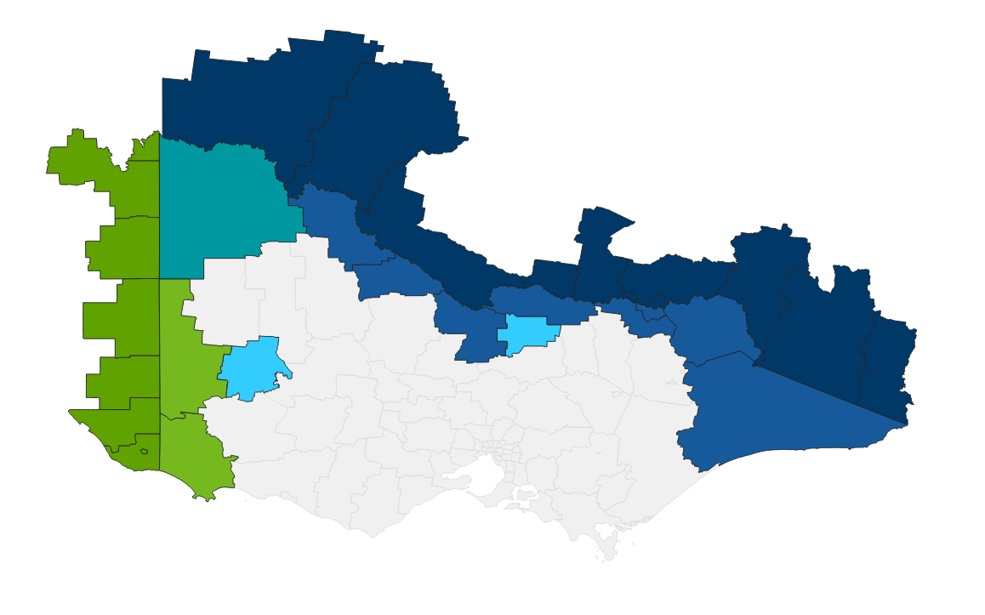

Cross Border Areas and LGA Population
Population of Cross Border Regions
Victoria | New South Wales | South Australia | Total
389,644 | 191,931 | 89,934 | 671,509
Population along VIC SA Border *MRCC included |  |  | 191,318
Population along VIC NSW Border *MRCC included |  |  | 537,500
Vic population on SA border only *MRCC included |  |  | 101,384
Vic population on NSW border only *MRCC included |  |  | 345,569
Renmark Paringa
Wentworth
Balranald
  Regional Population estimates, LGA, ABS 2025
Loxton Waikerie
Mildura
Swan Hill
Albury
Southern Mallee
Murray River
Gannawarra
Berrigan
Greater Hume
Snowy Valleys
Moira
Federation
Tatiara
Campaspe
Greater Shepparton
Wodonga
Indigo
Towong
Snowy Monara Regional
Naracoorte Lucindale
West Wimmera
Horsham
Bega Valley
Wattle Range
East Gippsland
Mount Gambier
Grant
Glenelg

Slide 2
Cross Border Areas and LGA Population
Renmark Paringa
Wentworth
Balranald
Loxton Waikerie
Mildura
Swan Hill
Albury
Southern Mallee
Murray River
Gannawarra
Berrigan
Greater Hume
Snowy Valleys
Moira
Federation
Tatiara
Campaspe
Greater Shepparton
Wodonga
Indigo
Towong
Snowy Monara Regional
Naracoorte Lucindale
West Wimmera
Horsham
Bega Valley
Wattle Range
East Gippsland
Mount Gambier
Grant
Glenelg

