Slide 1
Part 1: Regional Context & Priorities

Slide 2
Foreword by the
Ovens Murray Regional Partnership
The Ovens Murray Digital Plan was developed to guide and support a strong, innovative and inclusive digital future for our region – a key regional priority identified by community members at Regional Assemblies and other Ovens Murray Regional Partnership engagements.
We are very pleased that the Ovens Murray Regional Partnership had the opportunity, through the Victorian Government Connecting Regional Communities Program, to work with a group of passionate and talented regional stakeholders, and digital experts
from the statewide project team to produce the Ovens Murray Digital Plan.
The Victorian Department of Jobs, Precincts and Regions managed this project and
regional level coordination was undertaken by Regional Development Victoria–
Hume Region.
We are particularly grateful for the contribution by members of the Ovens Murray
Digital Plan Working Group, including representatives of local government, health, education, tourism, business, community and the telecommunications industry. The Regional Partnership also gained valuable input from a broader group of the region’s digital stakeholders at the Ovens Murray Digital Plan Strategic Directions and Priorities Workshop in March 2019.
The Ovens Murray region is well known for its unique environmental assets, vibrant
communities and lifestyle advantages, which are key drivers for population growth,
visitation and the success of our regional economy – all of which are increasingly dependent
on the region’s digital capability.
The Ovens Murray Digital Plan is the first step in what will be a longer term process. Technology
is moving fast and whilst the region is increasingly being recognised for its achievements in digital innovation, many people are being left behind.
The data tells us that many people in our region don’t have basic digital skills and are not engaging with digital technology. This is a major concern, as we are increasingly required to go online for our everyday living and work needs.
Our future success in the 21st century digital world requires understanding about regional digital needs, gaps and opportunities. Second, but no less important, is the action that flows from this knowledge, requiring people and resources to deliver what we need ‘on the ground’.
The Ovens Murray Digital Plan provides detailed data on technical supply and demand, as well as research findings about ‘lived experience’. It outlines the key issues for the region and identifies key areas we need to focus on going forward, as well as priority actions which will be a starting point for regional action and advocacy by the Regional Partnership.
We look forward to the Ovens Murray Digital Plan being used by our regional community, business, local stakeholders and all levels of government to support our region’s digital future.
Irene Grant Susan Benedyka
Chair Digital Portfolio Lead

Slide 3
Contents
PART 1: OVENS MURRAY DIGITAL PLAN – REGIONAL CONTEXT & PRIORITIES
Foreword by the Ovens Murray Regional Partnership
Executive Summary
What is a Digital Plan?
Ovens Murray Digital Plan Logic
Addressing the Digital Divide
Digital Issues Affecting All Regions
Digital Stakeholder Roles
Ovens Murray Region - At a Glance
Regional Snapshot
Ovens Murray Digital Landscape
Regional Initiatives & Networks
Showcasing Regional Digital Innovation
The Digital Divide
Assessment of Digital Supply and Demand Needs
Findings of Digital Supply and Demand Analysis
Findings from Local Government Survey and Stakeholder Consultations
Ovens Murray Region – Key Issues
Ovens Murray Focus Areas
Ovens Murray Priority Actions
Ovens Murray Priority Projects
Next Steps
PART 2: OVENS MURRAY DIGITAL PLAN - DATA COLLECTION FINDINGS & ANALYSIS
Section 1: OVENS MURRAY SUPPLY & DEMAND TECHNICAL ANALYSIS
Glossary
Context of the Digital Plan
Ovens Murray Regional Place/Sector Overview
Analytical Framework
Ovens Murray General Characteristics
Regional Supply Overview
Significant Places
Primary Production Areas
Tourist Destinations
Transport Blackspots
Appendix A - Acknowledgements and Qualifications
Appendix B – Fieldwork
Appendix C – Common Themes
Appendix D – LGA Digital Needs Report
Appendix E – Ovens Murray Stakeholder Study

Slide 4
Executive Summary
Unprecedented advances in digital technology are presenting both opportunities and challenges for community members, business and service providers in the Ovens Murray region and beyond.
The Ovens Murray Digital Plan, one of nine across Victoria, was launched by the Ovens Murray Regional Partnership in 2019. It was developed with guidance from Ovens Murray Digital Plan Working Group members – a committed group of local stakeholders from local government, health, education, tourism, business, community and the telecommunications industry.
A statewide project team from the Department of Jobs, Precincts and Regions (DJPR), under the Victorian Government’s Connecting Regional Communities Program provided expert technical input and coordinated the targeted local government and sector consultations.
In recent years, evidence has shown that there is a clear digital divide between metropolitan and regional areas and that, as part of Northern Victoria, Ovens Murray region has the lowest level of digital inclusion in Victoria.
A digital divide also exists within the region, with Ovens Murray also being an emerging digital leader in a number of areas, including digital innovation and entrepreneurship, digital collaboration and telehealth.
With its unique lifestyle advantages and pockets of digital excellence that are attracting innovators and entrepreneurs to the region and building local digital engagement, Ovens Murray has a solid foundation for its desired outcome – a ‘Smart Region’ that connects people, attracts talent, encourages innovation and creates jobs and growth for the 21st Century.
Development of the Digital Plan provided an important opportunity for the Ovens Murray Regional Partnership to work with community, business and service providers to consider the available data and other evidence; identify the region’s digital strengths, issues and needs; and develop a set of regional priorities.
The evidence base for the Ovens Murray Digital Plan includes digital supply and demand data, telecommunications coverage maps, advice from local government and discussions with regional industry and sector representatives from business, health, education and tourism.
Information was analysed for key locations (places) and sectors, as well as infrastructure supply and demand for fixed access broadband (including NBN), mobile networks, public WiFi and the low powered wide area networks (LP-WAN) that support the internet of things (IoT).
Findings were used to identify a set of focus areas and priority actions that will form the basis for Ovens Murray Regional Partnership advocacy to all levels of government, as well as informing engagement and collaboration with industry and community groups on digital priorities.

Slide 5





Key issues identified in Ovens Murray were:
One of the lowest levels of digital inclusion in Victoria for digital access (connectivity), digital affordability and digital ability, including basic skills
Poor awareness of digital opportunities
Variable NBN service availability and quality across the region, including lack of reliable business-grade broadband and system resilience
Inadequate mobile coverage, including mobile blackspots and inadequate mobile signal strength during peak times, particularly in tourism areas
Limited availability of free public WiFi
Relatively low availability and take-up of LP-WAN IoT technologies, particularly in the agriculture sector
Gaps in awareness about digital data opportunities and
cyber security
Support for ongoing regional leadership and collaboration to
eliminate the region’s digital divide and capitalise on its digital
strengths and opportunities.
Drawing from the data analysis, surveys and consultations, Ovens Murray region identified five focus areas and associated priority actions.
Digital Awareness
Increase digital awareness amongst businesses, services, industries and community members in order to improve access to digital services, training, good practice and opportunities.
Digital Skills
Support businesses, services, industries and community members to develop the skills and aptitude needed to access digital technology and innovate through the digital economy.
Digital Data Use
Encourage awareness about data management practices that ensure existing data is utilised to monitor, benchmark and improve good practice, including cyber security.
Digital Connectivity
Enhance the inclusivity, reach, optimisation and resilience of digital services that meet current and future needs, including fixed broadband, mobile telephone and data services (4G and 5G), public WiFi and LP-WAN IoT.
Digital Governance
Establish a framework for regional leadership and coordination to support initiatives that align with the region’s digital priorities and oversee progress on implementation of the Ovens Murray Digital Plan.

Slide 6
What is a digital plan?
The Ovens Murray Digital Plan is one of a set of nine digital plans
developed for each of Victoria’s Regional Partnership regions.
Each plan contains an evidence-based analysis of the supply and
demand for digital services and skills.
The Ovens Murray Digital Plan describes the region’s digital
landscape, gaps and opportunities, as well as identifying priority
actions that will strengthen the region’s digital future.
It forms the basis for Ovens Murray Regional Partnership
advocacy to all levels of government, as well as informing
engagement and collaboration with industry and community
groups. It will also be a valuable resource to other stakeholders
in the region for their own advocacy and action.
The Ovens Murray Digital Plan has two parts:
Part 1 (this report) presents a summary of the analysis
undertaken and the Regional Partnership’s key focus areas,
priority actions and projects.
Part 2 presents the detailed research and analysis undertaken in developing the Digital Plan and can be used by interested
stakeholders requiring more detailed information.
Ovens Murray Digital Plan Logic
The analytical framework and supporting research methodology for the Ovens Murray Digital Plan was developed by the DJPR statewide digital plan project team to systematically analyse digital infrastructure and skills supply, demand and other key information. The framework, glossary and findings from the three research ‘inputs’ for the Ovens Murray region are presented in full in Part 2 of the Ovens Murray Digital Plan.
At the regional level, development of the digital plan was coordinated by the Ovens Murray Regional Partnership.
Regional stakeholders played a key role as members of the Ovens Murray Digital Plan Working Group which was chaired by the Ovens Murray Regional Partnership Digital Portfolio Lead.
Working group members provided a strong regional voice that informed the background research and shaped the focus, priorities and projects outlined in Part 1 of the Ovens Murray Digital Plan.

Slide 7
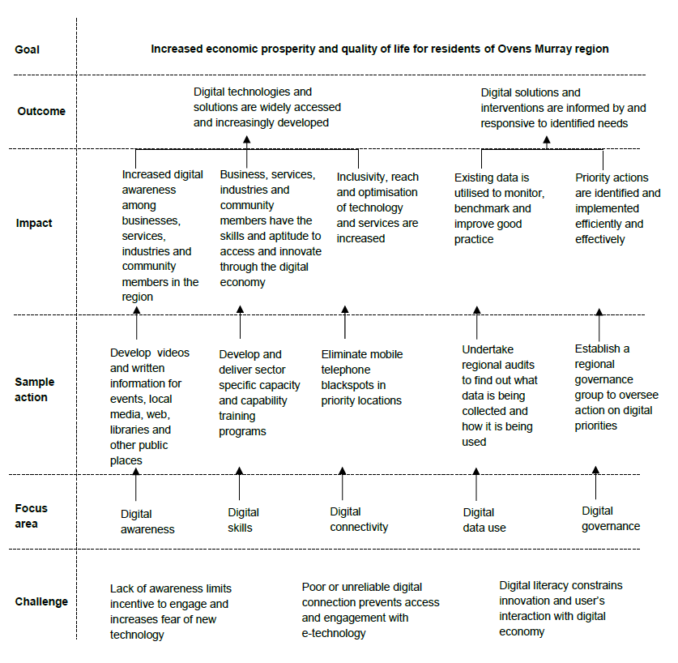
The Ovens Murray Digital Plan Working Group applied an outcomes logic based on change theory, to guide development of the digital plan focus and priorities.
This logic was used as the framework for the Digital Plan Strategic Directions and Priorities stakeholder workshop hosted by the Ovens Murray Regional Partnership in March 2019.
The Ovens Murray Digital Plan ‘logic’ is presented in the following graphic:

Slide 8



Addressing the Digital Divide
The Australian Digital Inclusion Index (ADII) has identified a persistent country-city digital divide which is demonstrated in Ovens Murray as part of the Northern Victoria region and defined as regional shortfalls in:
access to digital services
the ability to effectively use these
services
their affordability relative to their capital city counterparts.
A substantial digital gap has been found between regional Victoria and Melbourne and the size of the digital gap is different for each of Victoria’s regions:
2019 Northern Victoria region digital inclusion score – 54
2019 Rural Victoria digital inclusion score – 56
2019 Metropolitan Melbourne digital inclusion score – 65^
^ Rating from the 2019 Royal Melbourne Institute of Technology-Swinburne-Roy Morgan-Telstra Australian Digital Inclusion Index (ADII)

Slide 9









Digital issues affecting all regions
Fixed broadband – variable NBN service quality that is sufficient to meet resident, business and community service needs
Mobile coverage – prevalence of mobile telephone blackspots
IoT (Internet of Things) networks –variable availability of low-bandwidth networks to support the uptake of next generation technologies
Public WiFi – limited availability of free public WiFi for disadvantaged people, residents and tourists who require infrequent access
Access to government assets – shortfall in utilisation of all available assets to secure local service improvements
Digital skills – significant gaps in digital literacy, supply of IT professionals and workforce preparedness for the future
Six technology areas have been analysed in the Digital Plans to identify supply shortages in the regions:
Digital stakeholder roles
The digital landscape is a relatively complex environment that involves a number of government, non-government, business and community stakeholders. Outlined below is a high level description of ‘who does what’.
Local Government | Victorian Government | Commonwealth Government | NBN Co | Telco Industry
Identify local digital connectivity issues & opportunities to advocate & collaborate to progress digital priorities for the region. | Adopt a whole-of-state perspective on digital issues, advocate to Commonwealth, industry & Victorian stakeholders to identify & address issues; & coordinate & partner in policy development & investment across the state. | Set national policy & programs to ensure access to adequate digital services; & partner with states, local government and regional stakeholders to direct investment to priority areas. | Deliver & operate a high-capacity national broadband network. Deliver & upgrade infrastructure to meet user needs. Work with local stakeholders to inform rollout priorities. | Build & maintain digital networks & deliver services to users. Partner with Commonwealth & state programs to address digital issues.
Regional Partnerships | Networks & Interest Groups | Other Regional Stakeholders
Advocate to all levels of government & undertake collaborative action for the benefit of the region. | Collaborate to identify issues / opportunities & progress action to meet needs & maximise positive outcomes. | Community / business / services – contribute to solutions & inform improvements by sharing ‘lived experience’ & ideas.

Slide 10



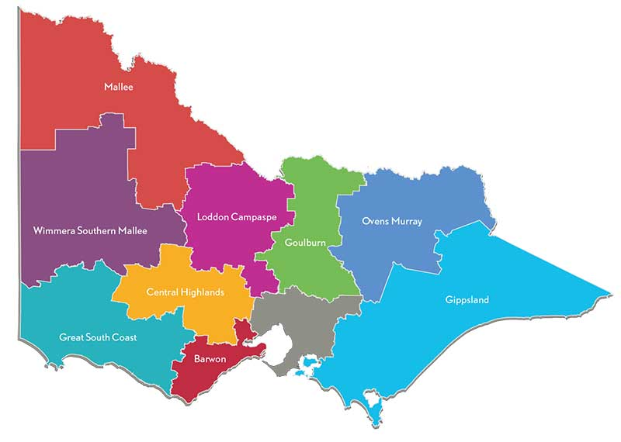
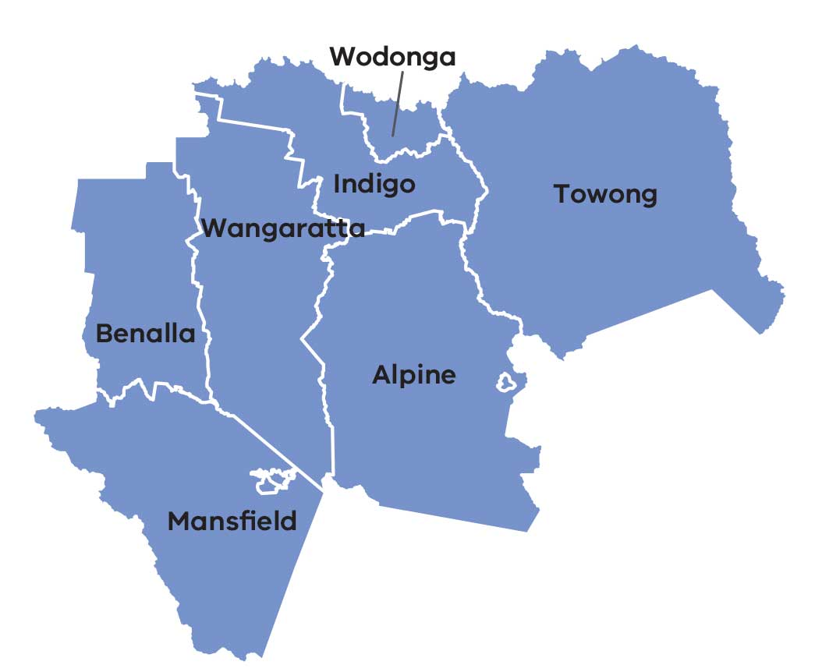



Ovens Murray Region –
At a glance…
Regional Partnership
The Ovens Murray Regional Partnership is one of nine non-metropolitan Regional Partnerships established across Victoria by the State Government in 2016.
This initiative recognises that local communities are in the best position to understand the challenges and opportunities faced by their region and provides a regional voice directly into the heart of government.
Low digital inclusion
Northern Vic Region = 54
(ADII 2019 )
$6.5 billion
Gross Regional Product
(GRP 2018)
125,428 residents
(ABS 2016)
Land Area
approx.
15,000 km²
Four Alpine Resorts
Falls Creek
Mount Hotham
Mount Buller
Mount Stirling
7 LGAs
Local government areas (population):
Alpine (12,500)
Benalla (14,000)
Indigo (16,000)
Mansfield (8,600)
Towong (6,000)
Wangaratta (28,500)
Wodonga (40,000)
Key Industries
(Employment)
Health/social care (14%)
Manufacturing (10%)
Retail trade (10%)
Tourism (9%)
Construction (8%)
Education and training (8%)
Public admin and safety (8%)
Agriculture / forestry (7%)
Primary Production
Grazing - sheep / beef
Horticulture / Viticulture
Dairy
Forestry

Slide 11
Regional Snapshot
Ovens Murray region is characterised by diversity of population settlements, landscapes, land use and economic activity.
Population density varies widely across the region with half the region’s residents living in the regional centres of Wodonga, Wangaratta and Benalla, and the remainder in a network of vibrant towns and more remote rural districts.
Whilst digital connectivity is more reliable in regional centres,
access to business grade broadband is relatively poor and
outside regional centres the digital user experience is less
favourable overall.
Alpine resorts and other tourist destinations offering year-round attractions, signature annual festivals and other periodic events, experience difficulties meeting digital demands during seasonal visitor peaks.
In a number of areas, poor communications network coverage and
lack of system resilience compound risk associated with system faults and emergencies.
The digital connectivity needs of primary producers, manufacturers, tourism operators and visitors are increasing and also differ across locations depending on the nature of their activities.
Reliable water supplies, four distinct seasons and fertile land support a diverse agribusiness sector across Ovens Murray.
Whilst livestock grazing (beef / sheep / dairy) is the region’s most economically significant primary production activity, the region is also recognised for its viticulture and horticultural commodities (grapes, apples, berries, nuts and hops), as well as niche crops and smaller-scale artisanal food production and value adding. The region also has a number of large food processing and distribution facilities.
Ovens Murray is also traversed by the nationally significant Hume transport corridor which has high volume freight and passenger movement on both road and rail.
Additionally, the region has a growing regional transport, distribution and logistics sector, all of which increasingly depend on reliable digital connectivity.
As well as digital infrastructure challenges, Ovens Murray as part of Northern Victoria, has consistently been the lowest ranked region in the state for ‘digital inclusion’, reflecting relatively low levels of access, affordability and digital ability. Despite the existence of significant digital disadvantage, there are examples of digital excellence across the Ovens Murray region.

Slide 12
Ovens Murray Digital Landscape
Ovens Murray region is increasingly being recognised as an emerging leader in digital innovation and entrepreneurship. As a transport corridor, tourism hub and tree-change destination of choice, the region is well positioned to capitalise on its resident and visitor population profile through digital revolution.
The variety of needs and opportunities has fostered creative digital solutions from tourism to agribusiness and health services to education. The lifestyle appeal of the region has drawn industry leaders and entrepreneurs who are innovating remotely and paving the way for communities to connect, transform and grow.
In Ovens Murray, residents can choose between the bustle of regional centres, the charm of historic towns, and the serenity of open hills, alpine valleys and snowfields. But the region’s demographic profile and sprawling geography, interspersed by alpine areas, also means digital awareness, connectivity and skills vary markedly.
Although Ovens Murray is an innovation leader in many areas, it also has a
clear digital divide. While many in the community using digital connectivity to transform business and create service delivery connections, many more have
yet to tap into the potential this digital revolution can provide. Businesses and
community members are too often simply unaware of the opportunities the digital economy can provide. Digital skills are variable, connectivity is patchy, particularly outside regional centres, and data usage capability is not being maximised.
Despite this, industries, businesses and communities in Ovens Murray are already embracing digital disruption. For example, when someone suffers a suspected heart attack in Bright, Mt Beauty or Myrtleford they can be remotely monitored by Ambulance Victoria and specialists at Northeast Health Wangaratta through tele-health technology at the local hospital. National and international online businesses have already been established in Benalla, Wangaratta, Wodonga, Beechworth, Bright and beyond. The GOTAFE Innovation Hub in Wangaratta is offering students high tech, hands-on learning experiences. Digital and innovation hubs, currently being established in Wangaratta and Wodonga, will provide safe virtual and physical spaces for learning, networking and start-up activity.
It is notable that in 2018 and 2019, the Ovens Murray region attracted over $1.8 million from the Victorian and Commonwealth Governments for eight local digital innovation initiatives, in addition to being highly successful in securing mobile blackspot funding.
Ovens Murray has also been growing its participation in the Victorian Digital Innovation Festival (DIF) over the past four years, delivering more activities every year from multiple locations across the region.

Slide 13
Regional Initiatives & Networks
Ovens Murray has a solid foundation from which to build, characterised by local champions, strong partnerships, cross sector collaborations and a broad range of digital innovation initiatives, including:
Wangaratta Digital Hub business case ‘in action’ – funded in 2018/19 State Budget
Wodonga Business Innovation Hub feasibility study ‘in action’ – funded in 2018/19 State Budget
Hume Life Tech Challenge, a regionally based, national competition for digital innovators – sponsored by Ovens Murray Regional Partnership in 2018
Startup Shakeup: Innovate NE Vic Startups, Benalla Council consortium with Indigo, Wangaratta and Mansfield councils –
funded by LaunchVic in 2018
Towong Think-Start-Grow collaboration with Towong Shire, ACRE and Think Digital – funded by LaunchVic in 2018
TheHUB 2019 Expert-in-Residence program, funded by LaunchVic
Australian Centre for Rural Entrepreneurship (ACRE) Breakout
Accelerator business incubator at the Old Beechworth Gaol – funded
by Commonwealth Government Incubator Support Initiative in 2019
Hume Telehealth Agency at Northeast Health Wangaratta
Centre for Digital Enterprise – Wodonga TAFE partnership with RMIT
University and Sunraysia TAFE
La Trobe Accelerator Program (Albury Wodonga Campus)
GOTAFE Innovation Hub (Wangaratta Campus)
Jewellers Coworking and Tech Hub
Galen Catholic College VEX Robotics and Mars Rover programs
Digital Technology Advisory Committee (DTAC) – Wangaratta based education providers working together to increase student participation in science, technology, engineering and mathematics (STEM)
Indi Telecommunications Action Group (ITAG) convened by Helen Haines MP, Member for Indi – working with local government to identify mobile blackspot priorities and communicate into government.
The region’s education sector has a number of flexible and technically rich education providers, delivering programs and collaborating to strengthen student engagement with STEM. Galen Catholic College’s VEX Robotics Program is internationally recognised and is hatching a number of young entrepreneurs who are active in the startup space. Regional leadership and coordination is also occurring through the Wangaratta based Digital Technology Advisory Committee (DTAC), comprising North East Tracks Local Learning and Employment Network (LLEN), Charles Sturt University (CSU), Galen Catholic College, Goulburn Ovens TAFE (GOTAFE), Wodonga TAFE and La Trobe University (Albury Wodonga).
Ovens Murray has also attracted and nurtured resident innovators and entrepreneurs, some of whom feature in a series of multimedia digital innovation stories launched by the Ovens Murray Regional Partnership in 2019 and are described on the following page.
Watch the videos and read the stories on the Regional Partnership website at: http://www.rdv.vic.gov.au/regional-partnerships/ovens-murray/projects.

Slide 14
Showcasing Regional Digital Innovation
Despite existing challenges, Ovens Murray region is home to a diverse population of innovators who are enjoying the region’s unique lifestyle benefits whilst developing their businesses, building entrepreneurial collaborations and creating learning opportunities through digital technology.
A set of multi-media stories developed by the Ovens Murray Regional Partnership and hosted on its website, showcases exciting innovations and unearths inspiring national and international success stories.
They highlight how technology facilitates community connection, enables work-life balance and provides economic and social
benefit to the region through jobs, training and improved services.
From Wangaratta to Mars
Wangaratta’s Digital Technology Advisory Committee and Galen College
Are working together with great success to improve digital participation and
Build the skills of the next generation of innovators with some help from robots.
Bright Tights Sold Globally
Combining professional knowledge with technology and a lifestyle choice, the
young couple featured in this story relocated to Bright to start their business and
are now producing customised active wear with integrated support.
Video Didn’t Kill These Radio Stars
Using their radio skills and experience, home-based and portable recording studios
and dreams of work and family balance in Beechworth, these two voice artists can run
their business from anywhere and work with clients across the globe.
Co-working Unearths a Gem
This Wangaratta co-working space above a former jeweller’s shop has connected a diverse group of people who would usually work in isolation and is delivering benefits for the whole community.
Crowdfunding for Superfine Idea
A world leader that is not well-known in Australia, this Benalla family’s superfine wool business has innovation in its DNA and has taken the leap to try crowdfunding for its latest product.
App Keeps People Moving
With 2,000 staff managing more than 200,000 transport movements a day during the Gold Coast Commonwealth Games, this Wangaratta business is challenging the big players in transport logistics technology.
Tech Reality Offers Start-up Options
What can Virtual Reality (VR) offer a business idea and teach us? Participants in a Towong Shire initiative are being inspired by VR and other technologies that support their entrepreneurial ideas and future learning.
Patient Outcomes Drive Telehealth
Using digital technology to connect patients across northeastVictoria to health specialists in other towns and cities is reaping rewards for patients, regional health professionals and the regional economy.

Slide 15
The Digital Divide
Despite areas of high level digital innovation and entrepreneurship, it is clear that a significant number of people in our community are not included in the uptake of digital technology and are already experiencing difficulties as everyday activities increasingly require people to go online.
Services, such as libraries and neighbourhood houses are increasingly being approached with requests for assistance as information provision, payments, learning, applications and registrations increasingly go online. People, including the most disadvantaged in
our community, are also increasingly being required to access educational resources and interact with government services online, including myGov and Centrelink.
Email, text messaging and social media are becoming the norm for communication within families, friendship networks and community groups, and many older people are struggling to make sense of
mobile telephones and tablets gifted to them by well-meaning family members. Cyber security is also a growing risk for both experienced
and inexperienced technology users who are exposed through online activities to risk of privacy breaches, exploitation and online scams.
Whilst there are regional examples of strong digital performance within some sectors, such as education and health, digital uptake in agribusiness is relatively low and the tourism sector is adjusting slowly to digital adaption in the region.
The digital divide between regional Victorian residents and businesses and their capital city counterparts – the gap between them in the availability of digital services, the ability of residents and workers to use digital services (digital skills), and the affordability of digital services and expertise – is reflected in the Australian Digital Inclusion Index (ADII) which measures these aspects in different locations. The ADII 2019 shows a substantial gap between residents in Melbourne and rural Victoria – with Melbourne scored at 65 and rural Victoria at 56.
Source: Victoria: Digital inclusion by geography (ADII 2018)
Roy Morgan, April 2017–March 2018

Slide 16
2019 | Australia | VIC | Melbourne | Rural VIC | Melbourne Regions |  |  |  |  |  | Geelong* | West VIC | North West VIC | North VIC | East VIC
 |  |  |  |  | West | North | Inner City | Central | Outer NE | Outer SE
ACCESS
Internet Access | 87.9 | 88.9 | 89.8 | 85.0 | 88.7 | 91.0 | 95.1 | 91.4 | 89.2 | 85.8 | 91.0 | 87.0 | 85.9 | 81.3 | 85.0
Internet Technology | 80.4 | 81.0 | 81.4 | 79.0 | 79.9 | 83.8 | 82.2 | 82.4 | 81.8 | 78.8 | 84.0 | 81.1 | 78.8 | 75.2 | 80.6
Internet Data Allowance | 58.7 | 60.9 | 62.3 | 54.0 | 60.8 | 66.0 | 63.7 | 62.7 | 64.1 | 57.8 | 69.0 | 55.8 | 53.6 | 51.0 | 55.1
 | 75.7 | 76.9 | 77.8 | 72.6 | 76.5 | 80.3 | 80.3 | 78.8 | 78.4 | 74.1 | 81.3 | 74.6 | 72.8 | 69.1 | 73.6
AFFORDABILITY
Relative Expenditure | 54.6 | 54.5 | 56.5 | 46.2 | 54.1 | 60.1 | 54.7 | 60.1 | 54.2 | 53.4 | 57.4 | 47.4 | 43.8 | 45.4 | 47.9
Value of Expenditure | 63.9 | 66.1 | 67.8 | 58.3 | 66.6 | 72.8 | 63.4 | 70.7 | 67.3 | 62.8 | 73.8 | 57.6 | 57.2 | 58.0 | 60.8
 | 59.2 | 60.3 | 62.1 | 52.2 | 60.3 | 66.5 | 59.0 | 65.4 | 60.7 | 58.1 | 65.6 | 52.5 | 50.5 | 51.7 | 54.4
DIGITAL ABILITY
Attitudes | 51.2 | 52.4 | 54.4 | 44.9 | 53.0 | 54.5 | 58.7 | 56.4 | 56.4 | 50.5 | 51.0 | 46.5 | 48.0 | 42.5 | 41.8
Basic Skills | 58.1 | 60.5 | 62.7 | 51.5 | 62.6 | 64.3 | 74.0 | 63.1 | 62.9 | 55.1 | 64.7 | 53.9 | 49.9 | 48.0 | 53.6
Activities | 43.1 | 45.1 | 47.5 | 35.5 | 46.1 | 49.6 | 56.8 | 48.9 | 47.1 | 40.8 | 47.9 | 37.6 | 35.1 | 32.5 | 36.4
 | 50.8 | 52.7 | 54.8 | 44.0 | 53.9 | 56.1 | 63.2 | 56.1 | 55.5 | 48.8 | 54.6 | 46.0 | 44.3 | 41.0 | 43.9
DIGITAL INCLUSION INDEX | 61.9 | 63.3 | 64.9 | 56.3 | 63.6 | 67.6 | 67.5 | 66.8 | 64.9 | 60.3 | 67.2 | 57.7 | 55.9 | 53.9 | 57.3
Source: Victoria: Digital inclusion by geography (ADII 2019)
Roy Morgan, April 2018–March 2019
It is important to acknowledge that people in Ovens Murray, as part of the Northern Victoria region, have consistently experienced the lowest level of digital inclusion in the State. The city-country digital divide is also significant and a digital divide also exists within regions – the most digitally disadvantaged being people in low income households; older Australians; people who did not complete secondary school; people with a disability; and people not in the labour market.
In addition to socio-economic factors, the digital divide within the region is compounded by characteristics such as geography, network design decisions and consequent technology boundaries, which mean there are also digital divides within the region’s cities, towns, neighbourhoods and rural/remote areas.
For example, where NBN infrastructure cuts over from fixed line to fixed wireless technology, or from fibre to the premise (FTTP) to fibre to the node (FTTN) within fixed line areas, businesses and homes on either side of the technology boundary will experience different service quality. Similarly, local topology and antenna settings can result in substantial quality differences within and between localities, even when in close proximity.
Furthermore, mobile telephone users are growing in number and have increasingly higher expectations of the services available on smartphones, ranging from traditional voice and critical emergency communications through to web browsing, data apps and video streaming. Once primarily considered for on-the-move outdoor use, mobile services are increasingly substituting for fixed services in the home and at work for a significant share of users.
Digital divides within communities and between businesses also exist for digital skills, experience and affordability, reflecting differences in individual and business digital proficiencies, age, income levels and exposure to high technology environments.

Slide 17




Assessment of Digital Supply & Demand Needs
Analysis of digital supply and demand was conducted on a place and sector basis across the region to provide the evidence base necessary for effective digital planning.^ Places and sectors in the region were analysed as follows:
→ Place/Sector Analysis
Significant Places looks at the demand and supply of digital infrastructure and services in the most populated cities, towns and localities of the region. | Primary Production looks at grazing, the most economically significant primary production industry in the region. | Tourist Locations looks at the supply of and demand for digital services in the most important tourist destinations in the region. | Transport Blackspots looks at the availability of mobile services along the region’s key transport routes.
→ Digital Infrastructure Analysis
Fixed access includes National Broadband Network (NBN) fixed-line broadband services including fibre to the premises (FTTP), fibre to the node (FTTN), fibre to the curb (FTTC), fixed wireless and satellite services. | Mobile availability of digital mobile networks capable of supporting high quality voice telephony and data applications such as through 4G and forthcoming 5G networks.
WiFi the availability of public WiFi services such as through public libraries and buildings, information centres and other local government initiatives. | LP-WAN IoT the availability of Low Powered Wide Area Networks (LP-WAN) that can support IoT applications like remote sensors and devices that are increasingly relevant to industry applications.
^ Note that a detailed description of the methodology and results of the analysis are contained in Part 2 of the Ovens Murray Digital Plan

Slide 18
Findings of Digital Plan Supply & Demand Analysis
→ Significant Places with a shortage of digital infrastructure
There are 13 cities and towns above 1,000 people in the Ovens Murray region. All of these locations have been analysed in this Digital Plan. Another five localities with less than 1,000 people were also included in the analysis to provide a broader perspective of different town sizes†.
The analysis has not looked comprehensively at smaller population centres with less than 1,000 people and looks exclusively at the town centre in each location, noting that this in effect misses people living nearby in sparsely populated areas where services tend to be worse.
While our analysis of public coverage maps indicates there is generally good 4G mobile coverage within population centres, we know from regional consultations that the ‘lived experience’ for many users can be quite different with continuing demand for better mobile infrastructure.
† based on 2016 ABS census data.
Number of places with unmet digital needs:
Of the 18 significant places analysed in the Ovens Murray region, it was revealed that:
Fixed access broadband had an intermediate supply shortfall for 14 cities/towns/localities*, indicating the widespread need for business broadband needs to be further considered and addressed. Two towns, Chiltern and Sawmill Settlement, were found to have a major supply shortfall for fixed access services.
Mobile coverage was assessed as adequate within the main population centres based on multiple carriers indicating they have 4G coverage in the area according to their coverage maps. However, there is concern whether these maps reflect the real-world experience of users, and what is not assessed here is how services deteriorate when moving beyond town centres. Only one town, Sawmill Settlement, was found to have an intermediate shortfall in mobile coverage. The impending rollout of 5G technology has the potential to uplift mobile services for early recipients, but smaller regional population centres are at risk of being left further behind.
Public WiFi access was a major or intermediate supply shortfall for eight places.
LP-WAN IoT was found to be reasonably good for the level of business, local government and household demand at present which is constrained by a lack of IoT knowledge and applications across the region. Four towns, Myrtleford, Bright, Mount Beauty–Tawonga South and Corryong, were found to have an intermediate supply shortfall for this service. Over the next 3-5 years demand is expected to grow strongly and closer attention will need to be paid to how these networks develop.
* Wodonga, Albury, Wangaratta, Benalla, Mansfield, Beechworth, Myrtleford, Bright, Rutherglen, Baranduda, Mount Beauty–Tawonga South, Corryong, Yackandandah, Oxley.

Slide 19

→ Analysis of Primary Production in the region
Sheep and beef grazing is the dominant primary production activity in the region, with horticulture/viticulture, dairy and forestry also being economically significant sectors.
The five locations analysed for the Ovens Murray Digital Plan cover sheep and beef grazing.
Legend
Grazing (sheep and beef)
North of Wangaratta
Around Corryong
Around Benalla
King Valley
Around Tallangatta
Fixed access broadband services for businesses involved in primary production needs to be addressed. In its current state, the digital infrastructure is unable to meet the region’s needs, with all primary production locations found to have a major supply shortfall in fixed access broadband services for business users.
According to publicly available coverage maps, mobile coverage appears to be mixed. Two locations revealed an intermediate supply shortfall˘ while three sites reported adequate coverage, although it has been highlighted through consultation that the ‘lived experience’ for residents and businesses is often poorer than what coverage maps suggest, owing to the detail and resolution limitations of the maps.
One location, around Corryong, was found to have an intermediate supply shortfall for LP-WAN IoT networks.
Mobile coverage nearer population centres is better than services available in more remote primary production locations, however obtaining a clear picture of where specific gaps exist or where there is weak and inadequate coverage is difficult with existing public data. Better quality coverage data is becoming increasingly important to identify priority locations in need of better mobile infrastructure.
Looking forward 3-5 years there is likely to be little market-driven improvement in mobile coverage, and 5G technology is unlikely to replace 4G in these locations. Rising demand in the face of a largely static supply will mean the unmet demand situation will worsen.
Internet-of-Things (IoT) technology uptake is likely to increase in the coming years, with the horticulture/viticulture and livestock producers predicted to be the early adopters in the Ovens Murray region.
Local government and regional businesses may increasingly need to leverage government assets for cost-effective bespoke solutions to increase bandwidth and improve reliability.
˘ Around Benalla and around Tallangatta.

Slide 20
→ Analysis of Tourist Locations
Tourist sites include year-round attractions, popular resorts and mountains, and signature trails or touring routes.
Tourist locations, including eight permanent tourist attractions, were assessed on the adequacy of digital infrastructure‡:
Rutherglen Wine Region
Murray to Mountains Rail Trailˆ
- Indigo
- Wangaratta
- Alpine
King Valley Prosecco Road
Ned Kelly Touring Routeˆ
- Indigo
- Wangaratta
- Mansfield
Mount Buffalo
Falls Creek
Mount Hotham
Mount Buller
Legend
Major supply shortfall
Intermediate supply shortfall
Current supply meets or exceeds demand⁺
F = Fixed access broadband
M = Mobile service coverage
Most locations have major issues with fixed access broadband services for operators. Tourist spots appear to have variable mobile coverage, with popular tourist locations/resorts generally served better, e.g. Mount Buller, Mount Hotham and Falls Creek, than the longer tourist routes spanning large areas and alpine regions.
F M
F M
F M
‡ Analysis combines operator and visitor user types.
ˆ Fixed access broadband is not applicable.
→ Analysis of Transport Blackspots
Road and rail transport corridors need good mobile coverage for continuous mobile connectivity. Seven transport corridors were analysed below:
Road Class | ID | From | To | Mobile Coverage
M | M31 | Baddaginnie | Wodonga | 4G coverage by 3 carriers
A | AB300 | Maindample | Rutherglen | 4G coverage by 3 carriers
B | B320 | Yarck | Mansfield | 4G coverage by 2+ carriers
 | B400 | Bundalong | Barnawartha | 4G coverage by 3 carriers
 | B400 | Wodonga | Towong Upper | Incomplete coverage
 | B500 | Wangaratta | Dinner Plain | Poor coverage in alpine regions
C | 54 roads |  |  | Good highway coverage in populated and low-lying areas; poor coverage of large areas of alpine terrain and low population density areas
Rail |  | Melbourne | Albury | 4G coverage by 3 operators for the whole route; good in-train reception Melbourne-Seymour; in-train reception testing required Seymour-Albury
Legend
Major supply shortfall
Intermediate supply shortfall
Current supply meets or exceeds demand⁺
⁺Note that there are reservations about the accuracy of ‘good coverage’ indicated by public coverage maps, which do not align with user experience reported by local stakeholders.

Slide 21
Findings from Local Government Survey & Stakeholder Consultations
What local government told us…
The seven local government authorities in Ovens Murray provided the following input in an online survey.
Most common negative impacts:
Poor digital competency and capability; poorer than expected NBN; lack of access to existing government telecommunications infrastructure; mobile phone coverage and reliability; and rural and farming areas most impacted, followed by tourism areas.
Barriers to digital adoption:
Connectivity for small and larger businesses and councils; training in basic skills for residential and business communities; and affordability for residents and small business.
Most important digital focus areas:
High quality digital connectivity between health care locations, professionals and patients; and digital services to support tourism areas.
What we learnt from industry & sector conversations…
Discussions (face-to-face and telephone) with 18 stakeholders from business, health, education and tourism provided the following input:
Challenges
Whilst needs are diverse, there is a shared view that investment in digital connection, skills and awareness are all required
Initiatives are relying on passionate individuals, and the lack of large-scale industry support and funding reduces their impact
Poor awareness of digital opportunities limits uptake and engagement in the region
Low digital literacy means that training must be built into regional initiatives
Talent is lost as skilled people move to metro areas in the absence of regional
digital opportunities.
Opportunities
Digital hubs offering expanded training to the wider community
Ag-tech education and better internet in remote locations
Telecommunications system resilience at Alpine Resorts
Cheap and accessible tech support for basic users
Digital leaders in region to become more actively involved
Also identified: eBikes; Fab labs; tracking apps; global networking; and SMART classrooms.
Note that the detailed findings of digital supply and demand analysis, local government surveys and stakeholder consultation are presented in Part 2 of the Ovens Murray Digital Plan

Slide 22


Ovens Murray Region – Key Issues
Key issues across the region were identified through consideration of the digital research findings and input from regional stakeholders :
Low level of digital inclusion
Ovens Murray sits within Australia’s Northern Victoria region which has consistently been the lowest ranked region in Victoria for digital inclusion according to the Australian Digital Inclusion Index (ADII). Digital inclusion is fundamental for participation in economic and social life, particularly as an ever increasing number of essential and community services and other forms of communications go digital. Particular barriers to online participation in our region are lack of basic skills and low levels of digital experience.
The Ovens Murray region has identified the importance of ‘digital inclusion’ as a key strategic priority, particularly given the potential for collaborative action at the local level that can have a real impact. The Ovens Murray Regional Partnership will continue to advocate to government for investment in digital awareness and skills and will work with its strong regional stakeholder network to implement priority actions relating to digital awareness and digital proficiency (skills) in order to increase safe and effective online participation in the region.
Digital connectivity - Lack of NBN business-grade services
The availability of adequate, affordable business-grade services for regional businesses across all NBN technology types is a major concern. This is despite the introduction of NBN’s Enterprise Ethernet business service, which due to technical limitations will not be accessible to many businesses because they have not received the higher capacity technologies in the NBN rollout.
The Ovens Murray region offers lifestyle advantages and work opportunities that are attracting innovators and entrepreneurs, as well as national and international business operators who require business-grade broadband services. The region is also a leader in telehealth and has expertise in digital transport coordination and logistics, which require business-grade services.
The Ovens Murray region has identified a priority need for reliable and affordable business-grade broadband services to support the region’s economy and service delivery systems. The Ovens Murray Regional Partnership will support a range of actions to address this need which is essential for the region’s economic prosperity.
Low uptake of Internet of Things (IoT) applications
The coverage of low bandwidth Internet-of-Things (IoT) networks for a range of sectors in the Ovens Murray region is relatively low compared to other regions across Victoria. The availability and knowledge of IoT applications and their value-proposition is limited in some sectors. It is important for regional businesses to engage with these next-generation, sensor-based business practices. Early adoption across the region can underpin productivity growth and competitiveness of industries. If the current demand trend continues the region risks being left behind.
The Ovens Murray region has identified the agribusiness (primary production) sector as a priority for stronger adoption of IoT technologies, including action to increase value-proposition awareness and knowledge of available technologies suited to the region’s smaller scale primary production and value-adding.
ˇbased on the Commonwealth National Mobile Black Spot Database, last updated October 2018

Slide 23


Digital connectivity - Inadequate mobile coverage
There is a persistent and significant divide in the quality of mobile services available to regional users compared to metropolitan users with important implications for public safety, economic development and general liveability. Regional users have emphasised this issue recently, registering 294 blackspotsˇ across the Ovens Murray region as part of the Commonwealth Government blackspot funding program, and raising concerns that during peak tourist season and major events mobile data services, including EFTPOS, are unreliable or unavailable.
Whilst it was necessary for the technical analysis in the digital plan to rely on public mobile coverage maps provided by the carriers, these have been shown to be too high-level and low resolution to enable accurate identification of ‘blackspots’ and areas with weak, unreliable or inadequate coverage. This means that while an area may appear well-served on a map, the ‘lived experience’ of regional users is often very different. In Ovens Murray this is a particular issue because the region has a geographically dispersed resident and visitor population across alpine and sub-alpine landscapes, river valleys and high risk bushfire areas, increasing mobile coverage needs and challenges.
The Ovens Murray Regional Partnership will continue to support local government identification of high priority mobile blackspots, provide regional coordination of mobile blackspot advice to the Victorian and Commonwealth governments, as well as explore opportunities to boost mobile strength during peak times.
Digital data & cyber security awareness
Increasing amounts of data are being captured worldwide, and Ovens Murray data capture is no exception. A range of users in the region are collecting and storing data on platforms that don’t inform each other, even when in the same operating environment. This results in unnecessary information duplication by system operators and customers/clients. Importantly, too little information is being consolidated and used to inform customer/client outcomes, business and sector growth. In addition, the importance of cyber security needs to be at the forefront of all online digital interactions to minimise the risk of personal harm through scams, and data breaches that can compromise integrity and privacy, and create system interference – all of which undermine the benefits of online engagement.
The Ovens Murray Regional Partnership acknowledges the responsibilities and challenges relating to data management and cyber security and will encourage awareness and good practice to embed data management and cyber security in risk assessments and relevant initiatives.
Digital collaboration & governance
It is often said within Ovens Murray that, ‘we get things done in this region because we are good at working together’. This is particularly important because Ovens Murray does not have a large dominant regional city that singularly attracts the majority of the region’s population, jobs and services, and acts as a ‘magnet’ for investment. To the contrary Ovens Murray has a geographically dispersed settlement pattern across three regional centres that support and are supported by a network of surrounding towns and villages.
Consequently, it is not surprising that the region already has a number of governance groups in the digital space and that digital governance was identified by regional stakeholders as a strategic regional priority for inclusion in the Digital Plan.
The Ovens Murray Regional Partnership affirms its commitment to ongoing collaboration and support for existing governance groups and will work with stakeholders on the Digital Plan Working Group to implement a cross-sector regional governance structure that meets regional needs for ongoing collaboration on digital priorities.

Slide 24
Ovens Murray Focus Areas
Ovens Murray Regional Partnership Digital Outcomes Statement:
Leading the way in digital inclusion, innovation and entrepreneurship – a ‘Smart Region’ that connects people, attracts talent, encourages innovation and creates jobs and growth for the 21st century.
A strong digital future is a necessary foundation for the overarching goal of increased economic opportunity and quality of life for residents in the Ovens Murray.
Regional stakeholders have expressed commitment to promoting equitable digital opportunity across the region and recognise that opportunity is born from access and aptitude; areas of focus that
the region’s priority actions will target.
Achievement of outcomes will require that digital technologies and solutions are widely accessable and continue to develop; and that digital solutions and interventions are informed by, and responsive to identified needs.
Drawing on stakeholder advice, research findings and the lived experiences
of communities, the Ovens Murray Regional Partnership has confirmed five
focus areas that align with the agreed outcome, goal and objectives. Each focus
area represents an opportunity to strengthen digital capability across
businesses, services and the community, to bridge divides and increase
community prosperity and wellbeing.
The five Ovens Murray focus areas, each of which has related priority actions, are:
Digital awareness
Digital skills
Digital data use
Digital connectivity
Digital governance.
The Regional Partnership will seek the support of regional interest groups, service providers and stakeholders, the Victorian and Commonwealth governments, and telecommunications carriers to play a role in progressing regional priorities.
The outcomes of Victorian Government digital initiatives will also be monitored for their applicability to Ovens Murray locations, including:
Connecting Regional Communities Program (CRCP)
Enhanced Broadband
Public WiFi
Victoria’s On-Farm Internet of Things (IoT) Trial
SmartSkills component of the SmartFarms initiative (part of the Victorian Skills Statement).

Slide 25
Ovens Murray Priority Actions
The Ovens Murray Regional Partnership is committed to promoting equitable digital opportunity across the region. In doing so, Ovens Murray will become a 'Smart Region' that connects people, attracts talent, encourages innovation and creates jobs and growth for the 21st century. Opportunity is born from access and aptitude – areas of focus that the region’s priority actions will target.
Drawing on research findings and the lived experiences of communities, the Ovens Murray Digital Plan Working Group has identified five focus areas and associated priority actions as set out below.
Digital Awareness
Access to digital services, training and good practice rely on the flow of information and knowledge about available opportunities. Whilst gaps exist, there are opportunities already available in the Ovens Murray region but too often they are being missed through lack of awareness.
Digital awareness priority actions
The Ovens Murray region will increase digital awareness among its businesses, services, industries, and community members through a set of priority actions, including:
Using the Ovens Murray Digital Plan to work with business and community stakeholders to develop the region’s digital profile and secure commitment for widespread action on digital priorities.
Developing and using accessible communications resources suitable for a range of potential and existing digital user groups through multiple types of media, such as print, video, web etc.
Continued storytelling to promote digital opportunities, challenges, solutions and successes, using local press and radio and displays at community events, field days, expos etc.
Getting information and services to people where they are, such as neighbourhood houses, libraries, men’s sheds, sporting clubs, community service and volunteer organisations etc.
Promoting resources, courses and knowledge through digital hubs, business incubators, neighbourhood houses, TAFE and university campuses, co-working spaces, tech libraries and adult education providers etc.
Supporting accessible, local community information sessions and activities that demystify online activity, promote safe digital engagement and create a pathway into skill development.
Building strong digital innovation networks / ecosystems at the regional, sub-regional and local level to share information, resources and experience.
Digital Skills
Digital skills are essential for basic online tasks at entry level and for design, implementation and engagement with digital solutions at higher levels of proficiency. Improving digital skills underpins removal of the digital divide and growth of the digital economy in the Ovens Murray region.
Digital skills priority actions
The Ovens Murray region will support businesses, services, industries and community members to have the skills and aptitude needed to access digital technology and innovate through the digital economy through a set of priority actions, including:
Developing and delivering broad based community and sector-specific education programs, including basic skills, through existing services, public facilities, workplaces and new initiatives.
Developing and promoting accessible, flexible and affordable access to skill development, including tech-help, skills banks, equipment libraries, digital hubs and drop-in support.
Encouraging provision and uptake of online delivery and interactive tools that build digital skills.
Supporting shared learning and development in the start-up culture through mentoring, incubators, pitch fests etc.

Slide 26
Digital data use
Data is already being captured by a range of users in the Ovens Murray, but too little information is being consolidated and used to inform business or sector growth and cyber security requires ongoing diligence.
Digital data use priority actions
The Ovens Murray region will encourage awareness about data management practices that ensure existing data is utilised to monitor, benchmark and improve good practice, including cyber security, through a set of priority actions, including:
Undertaking activities to better understand what data is collected and how it is used in the region.
Analysing what type of data is most beneficial to users.
Building a cohort of people/workforces to manage and interpret data.
Encouraging understanding of digital risk and cyber security amongst data managers and users.
Promoting and educating stakeholders on the benefits of high quality data collection, data use and data security.
Digital connectivity
Access to high functioning digital technology infrastructure and services is an
essential requirement for 21st century liveability and business operations. High quality
digital connection encourages uptake of existing and new technologies that connect
people, support service delivery, increase business productivity and underpin community
safety and resilience.
Digital connectivity priority actions
The Ovens Murray region will enhance the inclusivity, reach, optimisation and resilience of
digital services that meet current and future needs by:
Advocacy to:
Improve the reliability, capacity and coverage of NBN fixed broadband services, including business-grade and high capacity services, to meet the needs of residents, businesses and
service providers.
Provide mobile telephone coverage in priority blackspot areas and locations with poor/unreliable coverage, with consideration to isolated communities, high risk bushfire areas and tourism locations.
Provide affordable options to boost mobile signal and increase WiFi backhaul in locations where services such as eftpos, GPS navigation and mobile data are unavailable during temporary periods of peak demand.
Remove technical barriers to availability of IoT networks, particularly in areas where primary producers have potential to gain significant benefit.
Increase access to free public and site-specific WiFi in regional centres, disadvantaged communities and tourism locations, as well as extending access to multipurpose digital hubs that can address a range of access, affordability and technical support needs.
Explore opportunities to leverage available government assets and secure cost-effective customised solutions by using existing infrastructure.
Strengthen system resilience in ‘high visitation-high risk’ locations such as Alpine Resorts.
Improve awareness of customised solutions for people whose connectivity problems are unlikely to be resolved by mainstream system improvements.
Provide continuing access to technical supply and demand data so that the region can monitor progress on digital priorities and prepare for the rollout of 5G and other technologies that will support existing and future digital needs.
Innovative local solutions to:
Encourage cooperative initiatives that bring groups together to advocate for and implement digital solutions.
Develop a cohort of neighbourhood technicians - ‘nerds on call’ - who can provide localised tech support to those in need.
Assess feasibility of a consultation service – physical or crowdsourcing – that allows people to establish what telecommunication service is best for them in a particular location.

Slide 27
Digital governance
Ongoing leadership and coordination in the emerging digital economy will enable Ovens Murray to continue to build its capability and deliver the best outcomes for its communities.
Digital governance priority actions
The Ovens Murray region will establish a framework for regional leadership and coordination to support initiatives that align with the region’s digital priorities and oversee progress on implementation of the Ovens Murray Digital Plan through a set of priority actions, including:
Establishing a regional governance group / network with terms of reference, delegations and directorship to provide leadership and coordination, with consideration given to the following potential roles:
    Sharing information and connecting people in the regional digital ecosystem
    Supporting the development, implementation and evaluation of new initiatives and advising on program logic
    Maximising alignment of projects / initiatives to regional digital priorities and identifying opportunities to value-add
  Monitoring digital plan implementation and outcomes
  Identifying emerging regional digital needs
  Monitoring rollout of new technologies and customised solutions
  Advocating for available funding and providing advice on funding gaps, issues etc.
  Assisting establishment of working groups with appropriate membership and links
  Reporting back to relevant groups, including the Ovens Murray Regional Partnership.
  Engaging with existing regional networks and groups that are strengthening digital innovation, inclusion and connectivity in the region, including digital innovation project steering groups, Indi Telecommunications Action Group (ITAG) and Digital Technology Advisory Committee (DTAC).
  Developing and implementing a regional digital outcomes evaluation framework that is supported by high-quality regional level data.

Slide 28
Ovens Murray Priority Projects
The Ovens Murray Regional Partnership identified two initiatives for business case analysis within its digital planning project. These initiatives were chosen because they build on the region’s strengths in tourism and tele-health service delivery and respond to known community needs.
The business case analysis for each initiative will be used to determine its feasibility and inform next steps in relation to detailed planning, resourcing and potential implementation.
Real time, place-based digital tourism app
This initiative aims to develop a mobile way-finder, visitor guide and interpretive application for visitors to find out what’s on offer nearby, on that day and in the near future, and how to access that opportunity.
Research by Tourism North East, the tourism body in Ovens Murray, shows that the region’s High Country brand is having a strong impact, significantly increasing regional visitation. However, visitors report that when they are in the region, they find it difficult to obtain real-time information and independently find their way to destinations and activities of personal interest. The ‘tourism app’ will provide real
time, place-based information which enable visitors to have the
experiences on offer that best suit them.
Digital maternal platform
This initiative aims to support mother-baby health and wellbeing through a mobile application that can be used from 12 weeks gestation through to a baby’s first year of life. It includes high quality information, a midwife portal and health trackers for mother and baby.
The digital maternal platform project builds on the groundbreaking work of the Hume Telehealth Agency at Northeast Health Wangaratta, which aims to connect patients and health providers using digital technology to deliver more accessible health care.

Slide 29
Next Steps
The findings and recommendations identified in the Ovens Murray Digital Plan will form the basis
of advocacy by the Regional Partnership into Commonwealth, Victorian and local governments, as well as ongoing regional collaboration and support for industry and community groups that can contribute to the region’s digital future.
The Ovens Murray Digital Plan highlights gaps and opportunities to improve digital awareness, skills, connectivity, data use and governance. It also identifies where some future demands may lie, bringing to light areas where efforts can be focused to bridge the digital divide between metropolitan and regional Victoria and within the Ovens Murray region. By addressing priority needs, we will maximise the potential for local residents, businesses and community to flourish as the digital age continues to advance, building a strong digital future for the region.
The outcomes of relevant government initiatives will also be monitored for their applicability to Ovens Murray region, including:
Connecting Regional Communities Program
Victoria’s On-Farm IoT Trial
SmartSkills / Smart Farms
Enhanced Broadband
Public WiFi
The Ovens Murray Regional Partnership sincerely thanks members of Ovens Murray Digital Plan Working Group and other committed regional stakeholders who generously gave their time and shared their knowledge, providing a highly valued contribution to the development of the
Ovens Murray Regional Digital Plan.
Working group members will continue their involvement to establish a regional governance structure and engage others to assist implementation of priority actions and achievement of outcomes outlined in the Digital Plan.
Contact Us
If you would like to discuss the Ovens Murray Regional Digital Plan please contact the Ovens Murray Regional Partnership on:
Email: ovensmurray.partnership@rdv.vic.gov.au
Phone: (03) 5722 7103
We look forward to hearing from you.

