Slide 2
Loddon Campaspe Regional Partnership Foreword
Loddon Campaspe is a broad, diverse and fast-growing region with a range of attributes and advantages that can be leveraged to establish ourselves as a clear regional leader in digital connectivity.
The region’s geography supports the deployment of core digital infrastructure to most major population centres, building off an existing high-capacity backbone infrastructure. Loddon Campaspe is home to sophisticated business users that drive demand for skills development; and our collaborative businesses and community position us strongly to identify and progress digital opportunities.
While the opportunity for Loddon Campaspe to be a digital leader is clear, there remain digital connectivity issues across the region impeding our ability to build an inclusive digital economy. We hear this from stakeholders consistently and live this reality but have not had the comprehensive evidence to track the problem effectively.
This is why the Loddon Campaspe Regional Partnership is proud to present our Digital Plan. This plan is the first of its kind for the region and provides the evidence base to facilitate planning and advocacy by the Regional Partnership and Loddon Campaspe stakeholders on our digital issues and priorities.
The Loddon Campaspe Digital Plan outlines key connectivity issues affecting the region and sets out the Regional Partnership’s recommendations aimed at addressing the digital connectivity gaps. It also sets out our digital connectivity vision, to become a national regional leader on digital connectivity and use to underpin the growth, competitiveness and resilience of our businesses and industries and drive social outcomes.
Loddon Campaspe has the potential to realise significant economic and social development opportunities by leveraging our advantages through continued and determined effort. Our Digital Plan is just one driver to realise our digital vision– there is still more work to be done, but we have made considerable progress with this plan to support future efforts.
I would like to thank everyone whose efforts have made this plan possible, particularly our digital working group. I am excited to see the changes the Loddon Campaspe region will undergo in the years to come as we work towards bringing our digital vision to life.
David Richardson
Acting Chair
Loddon Campaspe Regional Partnership

Slide 3
What is a Digital Plan?
The Digital Plan for each region is an evidence-based, place-based analysis of the supply of and demand for digital services and skills.
The Loddon Campaspe Digital Plan identifies gaps in the region’s current digital infrastructure landscape and makes recommendations on how these gaps can be addressed.
The Digital Plan forms the basis of our Regional Partnership’s advocacy to all levels of government, as well as industry and community groups. It will also be a valuable resource to other stakeholders in the region for their own advocacy and action.
Addressing the Digital Divide
Victoria’s Regional Digital Plans are the first of their kind, filling the critical information gap needed to effectively reduce the persistent country-city digital divide, defined as regional shortfalls in:
access to digital services,
the ability to effectively use these services,
and their affordability relative to their capital city counterparts.
A substantial digital gap has been found between regional Victoria and Melbourne:
2019 Rural Victoria digital inclusion score – 56
2019 Metropolitan Melbourne digital inclusion score – 65^
^ Rating from the 2019 Royal Melbourne Institute of Technology-Swinburne-Roy Morgan-Telstra Digital Inclusion Index (DII)

Slide 4
Our Vision for the region
The Loddon Campaspe Regional Partnership’s vision is for the region to be a national regional leader on digital connectivity and use to underpin the growth, competitiveness and resilience of our businesses and industries and drive social outcomes.
There are a variety of valuable and difficult to replicate elements of our digital landscape which present Loddon Campaspe with a compelling opportunity to be digital leaders:
1
Favourable geography to support high-capacity infrastructure deployment
Loddon Campaspe’s linear geography presents cost advantages to developing a network of high-capacity digital locations which can be relatively easily accessed by nearly all people and businesses across our region.
Sophisticated business users driving demand for skills and services
To get the most out of digital infrastructure and attract and retain the right sort of talent to do so, a region needs a critical mass of sophisticated technology users. Loddon Campaspe is well established in this regard. The region is home to organisations like La Trobe University, Bendigo Telco, Coliban Water and multiple data centres dedicated to the region.
2
3
Collaborative business and community environment
The Loddon Campaspe local governments share a ‘region first’ view for economic and social development, placing a high value on initiatives that take a whole-of-region approach rather than disparate, uncoordinated efforts and initiatives.
High capacity digital infrastructure already in place
Loddon Campaspe boasts a range of digital assets that provide the beginnings of a more comprehensive rollout across the key hubs of the region.
4
Between the infrastructure gaps identified in the Digital Plan and the existing elements described above we have the pieces we need to set Loddon Campaspe apart as a digital leader.

Slide 5
Loddon Campaspe’s Priority Projects
Project 1
Analyse the benefits of utilising the existing infrastructure & platforms and assets to support other digital initiatives across the region, including those listed below.
Project 2
Roll out very fast connectivity in Bendigo and the region’s other major centres, including along the Gisborne - Bendigo - Echuca corridor.
Project 3
Roll out free public WiFi in the region’s major and smaller centres, as has been done with the Victorian and local government supported free public WiFi network in Bendigo.
Project 4
Rural community access to telehealth is needed to reduce the health inequalities in health service access and provision. Infrastructure investment is required to enable both group activity in larger spaces and more private telehealth access to consult geographically distant health professionals.
Project 5
Develop Loddon Campaspe as a “smart region” with IoT applications to improve social amenity, environmental sustainability and economic efficiency across the region.

Slide 6
Digital issues affecting all regions
Fixed broadband – ensuring NBN service quality is sufficient to meet resident and business needs
Mobile coverage – investigating the prevalence of blackspots
IoT (Internet of Things) – availability of low-bandwidth networks to support the uptake of next generation technologies
Public WiFi – availability of free public WiFi for tourists and disadvantaged residents
Access to government assets to improve services locally
Digital skills – assessing digital literacy, supply of IT professionals, and workforce preparedness for the future
Six technology areas have been analysed in the Digital Plans to identify supply shortages in the regions:
Loddon Campaspe’s Priority Recommendations
The Loddon Campaspe Digital Plan makes a series of recommendations to different stakeholder groups for their action. These recommendations include:
Local Government | Victorian Government | Commonwealth Government | NBN Co | Telco Industry
uses their local presence, insights and planning powers to identify localised priority fixed and mobile blackspots, promote early 5G rollout, seeks to leverage state-owned assets to extend higher-capacity infrastructure to priority areas and supports digital literacy training (possibly in local digital hubs). | reviews and extends its regional telecommunications advocacy, co-investment funding and pilot programs; addresses unmet needs with targeted high-speed broadband deployment; facilitates regional IoT and 5G developments; leverages procurement for local stakeholder and business economic opportunities, invests in digital skills training programs and facilitates access to state-owned digital infrastructure assets. | continues, reviews and extends its mobile blackspot co-funding program, mandates industry to meet stronger NBN service connection and maintenance requirements, invests in addressing IoT blackspots and supports the delivery of public WiFi networks in priority locations. | quickly brings to market effective business-grade services with strong service level agreements (SLAs). | actively considers opportunities to provide competing broadband services to businesses in high demand precincts, particularly if NBN Co fails to restructure its wholesale pricing or does not provide effective business grade services, and releases more informative public coverage maps to inform future investments.

Slide 7
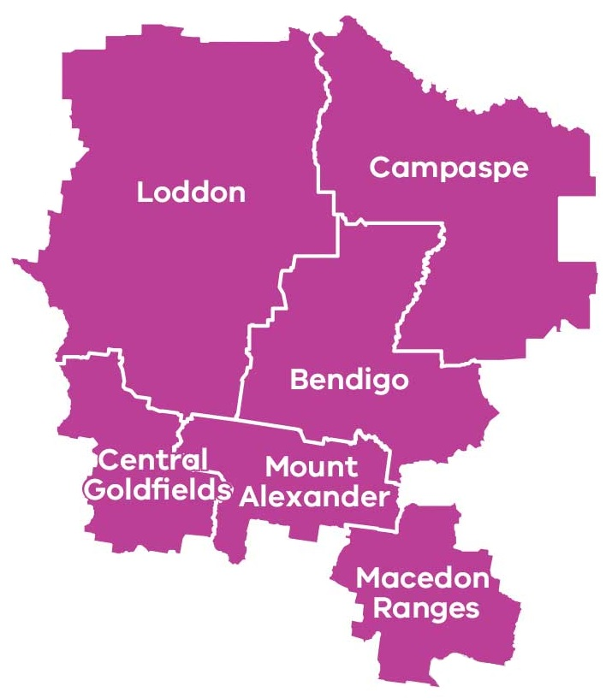
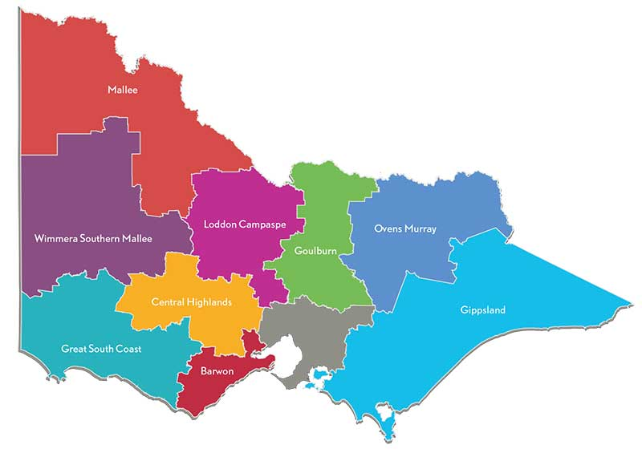
Loddon Campaspe Regional Partnership – At A Glance
The Loddon Campaspe Regional Partnership is one of nine Partnerships across the state, established by the Victorian Government, recognising that local communities are in the best position to understand the challenges and opportunities faced by their region.
Approx. 19,000 km²
236,000 residents
as of 2017
Key Industries
Health care and social assistance (15%)
Retail trade (10%)
Manufacturing (9%)
Education and training (9%)
Construction (9%)
Tourism (8%)
Agriculture, forestry, fishing (6%)
Public admin and safety (6%)
6 LGAs
Local government areas (population):
Bendigo (112,000)
Campaspe (37,000)
Central Goldfields (13,000)
Loddon (7,000)
Macedon Ranges (48,000)
Mount Alexander (19,000)
Primary Production
Beef grazing
Dairy grazing
Sheep meat and wool grazing
$10.5 billion
Gross Regional Product (GRP)

Slide 8
Assessment of Digital Needs
Analysis of digital supply and demand is conducted on a place and sector basis across the region to provide the evidence base necessary for effective digital planning. Places and sectors in the region have been analysed as follows:
→ Place/Sector Analysis
Significant places looks at the demand and supply of digital infrastructure and services in the most populated cities, towns and localities of the region. | Primary production looks at the most economically significant primary production industries in the region. | Tourist locations looks at the supply of and demand for digital services in the most important tourist attractions / locations in the region. | Transport blackspots looks at the availability of mobile services along the region’s key transport routes.
→ Digital Infrastructure Analysis
Fixed access includes National Broadband Network (NBN) fixed-line broadband services including Fibre-to-the-Premises (FttP), Fibre-to-the-Node (FttN), Fibre-to-the-Curb (FttC), Fixed Wireless and Satellite. | Mobile availability of digital mobile networks capable of supporting voice telephony and data applications such as through 3G and 4G networks.
WiFi the availability of public WiFi services through public libraries and buildings, information centres and other local government initiatives. | LP-WAN IoT the availability of Low Powered Wide Area Networks (LP-WAN) that can support Internet of Things (IoT) applications like remote sensors and devices that are increasingly relevant to industry applications.

Slide 9
Loddon Campaspe Regional Partnership – Key Issues
The Loddon Campaspe Regional Partnership has identified the following key issues for the region:
Inadequate mobile coverage
There is a persistent and significant divide in the quality of mobile services available to regional users compared to metropolitan users with important implications for public safety, economic development and general liveability. Regional users have emphasised this issue recently, registering 312 blackspotsˇ experienced across the Loddon Campaspe region as part of the Commonwealth’s black spot funding program.
The Digital Plan has necessarily relied on public mobile coverage maps provided by the carriers. The analysis reveals the maps to be too high-level and low resolution to enable detailed identification of areas where coverage is unreliable, weak and/or incapable of supporting the data services which users have come to expect to access ‘on-demand’. This means that while an area may appear well-served by these maps, the lived experience of regional users is often very different. The analysis summarised on the following pages should be read with this in mind. Better data in the future can provide a more complete picture about mobile coverage issues within towns and in areas not yet analysed by the Digital Plans.
The Regional Partnership calls for continued Commonwealth and State funding to address mobile coverage issues and better data from carriers to enable more informed funding decisions.
Low up-take of Internet of Things (IoT) applications
The coverage of low bandwidth Internet-of-Things (IoT) networks for agriculture, logistics, delivery of “smart city” public services and other sectors is reasonable at the moment, but availability and knowledge of IoT applications and their value proposition is limited. It is important for regional businesses to engage with these next-generation sensor-based business practices. Early adoption across the region can underpin productivity growth and competitiveness of our industries. If the current demand trend continues, we risk being left behind.
The Regional Partnership has identified narrowband and broadband IoT coverage across the region as a priority for the region.
Lack of NBN business-grade services
The availability of adequate, affordable and reliable business-grade services for regional businesses across all NBN technology types remains a concern. This is despite the introduction of NBN’s Enterprise Ethernet business service, which due to technical limitations will not be accessible to many businesses who have not received the higher capacity technologies in the rollout.
The Regional Partnership calls on the Commonwealth, NBN Co and the Victorian Government to prioritise actions that can address underserved regional business precincts with high-capacity business-grade broadband services.
ˇbased on the Commonwealth National Mobile Black Spot Database, last updated October 2018

Slide 10
Findings of the Digital Plan
→ Significant Places with a shortage of digital infrastructure
There are 15 cities and towns above 1,000 people in the Loddon Campaspe Regional Partnership. All of these locations have been analysed in this Digital Plan. Another six localities with fewer than 1,000 people were also included in the analysis to provide a broader perspective of different town sizes†.
The analysis has not looked comprehensively at smaller population centres with fewer than 500 people and looks exclusively at the town centre in each location, noting that this in effect misses people living nearby in sparsely populated areas where services tend to be worse.
While our analysis of public coverage maps indicates there is generally good 4G mobile coverage within population centres, we know from regional consultations that the lived experience for many users can be quite different with continuing demand for better mobile infrastructure.
† based on 2016 ABS census data.
Number of places with unmet digital needs:
Of the 21 significant places analysed in the Loddon Campaspe region, it was revealed that:
Fixed access broadband had an intermediate supply shortfall for 19 cities/towns/localities*, indicating the widespread need for business broadband needs to be further considered and addressed.
Mobile coverage was assessed as adequate within the main population centres based on multiple carriers indicating they have coverage in the area according to their coverage maps. However, there is concern whether these maps reflect the real-world experience of users, and what is not assessed here is how services deteriorate when moving beyond town centres. The impending rollout of 5G technology has the potential to uplift mobile services for early recipients, but smaller regional population centres are at risk of being left further behind.
Public WiFi access was a major or intermediate supply shortfall for nine places.
LP-WAN IoT was found to be reasonably good, with the exception of the town of Heathcote, for the level of business, local government and household demand at present which is constrained by lack of IoT knowledge and applications across the region. Over the next three-to-five years demand is expected to grow strongly and closer attention will need to be paid to how these networks develop.
* Bendigo, Echuca, Castlemaine, Maryborough, Kyabram, Kyneton, Romsey, Woodend, Riddells Creek, Macedon, Rochester, Heathcote, Lancefield, Tongala, Maldon, Rushworth, Boort, Malmsbury, Newstead.

Slide 11
→ Analysis of Primary Production in the region
Primary production in the region revolves around dairy and beef grazing, and sheep meat and wool grazing. While broadacre cropping was not explicitly analysed within the Digital Plan, it is an important aspect of the region’s primary production.
The five locations analysed cover most of the major types of primary production seen throughout the Loddon Campaspe region.
Legend
Dairy grazing
Dairy and beef grazing
Sheep meat and wool grazing
West of Mitiamo
North of Kyabram
Around Rochester
North-east of Maryborough
North-east of Woodend
Fixed access broadband services for businesses involved in primary production needs to be addressed. In its current state, the digital infrastructure is unable to meet the region’s needs, with all locations found to have a major supply shortfall in fixed access broadband services for business users.
According to publicly available coverage maps, mobile coverage appears to be mixed – one location, west of Mitiamo (dairy grazing), revealed an intermediate supply shortfall for business and home users. Despite four sites reporting adequate coverage, it has been highlighted through consultation that the lived experience for residents and businesses is often poorer than what coverage maps suggest, owing to the detail and resolution limitations of the maps.
Only one of the locations, north-east of Maryborough, was found to have an intermediate supply shortfall for LP-WAN IoT supported services but demand is expected to rise.
Mobile coverage nearer population centres is better than services available in more remote primary production locations, however obtaining a clear picture of where specific gaps exist or where there is weak and inadequate coverage is difficult with existing public data. Better quality coverage data is becoming increasingly important to identify priority locations in need of better mobile infrastructure.
Looking forward three-to-five years there is likely to be little market driven improvement in mobile coverage, and 5G technology is unlikely to replace 4G in these locations. Rising demand in the face of a largely static supply will mean the unmet demand situation will worsen.
Local governments and regional businesses will need to consider leveraging government assets for cost-effective bespoke solutions, and the Commonwealth and Victorian Governments should develop more flexible mobile blackspot programs tailored to the region and its needs.

Slide 12
→ Analysis of Tourist Locations
Tourist sites include year-round attractions, signature annual festivals, periodic events, and hiking trails that are frequently visited.
Tourist locations, including seven permanent spots, five events and two trails were assessed on the adequacy of digital infrastructure‡:
Loddon Valley Food and Wine Expo
Murray River
Melville Caves Picnic Area - Kooyoora State Park
Riverboats Music Festival
Southern 80
Maryborough Highland Gathering
Central Deborah Gold Mine
Energy Breakthrough
O’Keefe Rail Trail
Paddys Ranges State Park Maryborough
Victorian Goldfields Railway
Talbot Farmers Market
Newstead Live
Turpins Falls
Legend
Major supply shortfall
Intermediate supply shortfall
Current supply meets or exceeds demand⁺
Art in the Vines
F M
F = Fixed access broadband
M = Mobile service coverage
Hanging Rock
F M
Goldfields Track
F M
All tourism locations have issues with fixed access broadband services. Half of the tourist spots analysed appear to have adequate mobile coverage based on public coverage data, but national parks, rivers and trails are underserved.
‡ Analysis combines operator and visitor user types.
→ Analysis of Transport Blackspots
Road and rail transport corridors need good mobile coverage for continuous mobile connectivity. Fourteen transport corridors were analysed below:
Road Class | From | To | Mobile Coverage
A/B | Sunbury | Ravenswood | 4G coverage by three carriers
 | Charlton | Wedderburn | 4G coverage by three carriers
 | Ravenswood | Marong | 4G coverage by three carriers
 | Bendigo | Macorna | Continuous 4G coverage by one carrier only
 | Bendigo | Heathcote | Continuous 4G coverage by at least two carriers
 | Bendigo | Stanhope | Continuous 4G coverage by three carriers
 | Gunbower | Wyuna | Continuous 4G coverage by one carrier only
 | Echuca | Heathcote | Continuous 3G coverage or better by two carriers
 | Elphinstone | Avoca | Continuous 4G coverage by at least two carriers
 | Marong | Logan | Continuous 4G coverage by one carrier only
C | 86 roads |  | Patchy/low coverage
Rail | Bendigo | Melbourne | 4G coverage by three carriers
 | Bendigo | Echuca | 4G coverage by three carriers
 | Bendigo | Swan Hill | Continuous 3G coverage or better by two carriers
 | Ballarat | Maryborough | Continuous 3G coverage or better by two carriers
Legend
Major supply shortfall
Intermediate supply shortfall
Current supply meets or exceeds demand⁺
⁺Note that there are reservations, based on local mobile access experience, about the good coverage indicated by public coverage maps.

Slide 13
Next Steps…
The analysis and recommendations that have come out of the Loddon Campaspe Digital Plan will form the basis of our Regional Partnership’s advocacy to the Commonwealth, Victorian and local governments, as well as industry and community groups in developing the future digital landscape of our region.
This Digital Plan highlights the region’s current gaps in digital infrastructure and where our future demands may lie, bringing to light the areas where our efforts should be focused to bridge the digital divide. By addressing these priority areas, we will ensure our local residents, businesses and community flourish as the digital age continues to advance.
The Loddon Campaspe Regional Partnership would like to thank the members of Loddon Campaspe Regional Digital Plan Working Group who gave their time, thoughts and passion towards the development of the Loddon Campaspe Regional Digital Plan.
Contact Us
If you would like to discuss the Loddon Campaspe Digital Plan please contact the Loddon Campaspe Regional Partnership on:
Email: loddoncampaspe.partnership@rdv.vic.gov.au
We look forward to hearing from you.

